Slide 1
Quarterly Update on the National Emissions Inventory Collaborative
January 23, 2020

Slide 2
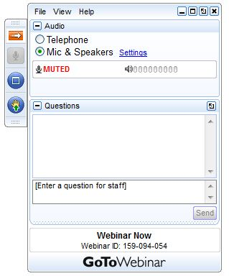
Webinar Ground Rules: Questions?
Each workgroup will give a ~5 minute update describing their work on the 2016v1 platform.
All call participants will remain on mute during the webinar.
Type your questions into the question box on the webinar client.
We will try to answer questions at the end of the webinar.
We will create a Q&A document following the webinar and post with the meeting notes on the Collaborative Wiki: http://views.cira.colostate.edu/wiki/wiki/9169

Slide 3
Overview of the Platform Collaborative
A multi-purpose emissions modeling platform (EMP) is needed
State Implementation Plans, federal analyses
For the first time, EPA, states, and MJOs are engaging in collaborative EMP development
The 2016 base year was selected via a collaborative process
Future years selected due to regulatory relevance
2023 is relevant for Ozone NAAQS moderate areas
2020 is being created by some states/regions for 2008 O3 NAAQS attainment demonstration modeling
2028 for regional haze

Slide 4
2016 EMP Schedule
Several versions of 2016 platform were developed
Alpha: preliminary version based on 2014NEIv2 for some and 2016 for other key sectors (released Spring, 2018)
For initial testing of 2016 model runs
Compatible versions of 2014 and 2015 were also released
https://www.epa.gov/air-emissions-modeling/2014-2016-version-7-air-emissions-modeling-platforms
Beta: improved 2016 emissions for most sectors (March 2019) and preliminary projected emissions for 2023 and 2028 (to workgroups in April 2019)
V1.0: fully updated 2016 emissions and complete projected emissions for 2023 and 2028 (October 2019)

Slide 5
Organizational Structure
Coordination co-leads: Zac Adelman (LADCO) and Alison Eyth (EPA OAQPS)
Developed process and communication structures, facilitate discussions, help resolve issues, documentation requirements, coordinate distribution of data to stakeholders
Coordination committee: regional, state, EPA leaders
Define processes, resolve issues, co-lead workgroups
Includes overall and WG co-leads plus MJO directors
Sector-specific Workgroups: one regional/state staff and one EPA staff (where possible)
Focus on preparing emissions estimates for 2016 and future years, plus improve how the emissions sectors are modeled
Include participants from EPA/states/locals/regions

Slide 6
Objectives of Today’s Webinar
Describe release contents and how to obtain the 2016v1 data and modeling files
Recap what is in 2016v1 versus beta
Summarize and share analyses of the v1 platform
Discuss the next steps for the Inventory Collaborative

Slide 7
2016v1 Release Contents
Type | Grid(s) | Models
2016 SMOKE inputs and scripts | 12km, 36km | CMAQ, CAMx
2016 SMOKE outputs by sector (aka pre-merged emissions) | 12km, 36km | CMAQ*
Emissions plots, summaries | 12km, 36km | N/A
Documentation (i.e., spec sheets) | N/A | N/A
Met data for AQM (same as beta) | 12km, 36km | CMAQ, CAMx
IC/BCs (same as beta) | 12km, 36km | CMAQ, CAMx
Site Compare Files (same as beta) | N/A | CMAQ, CAMx
2023 and 2028 SMOKE inputs and scripts | 12km, 36km | CMAQ, CAMx
2023 and 2028 SMOKE outputs | 12km, 36km | CMAQ, CAMx
NOT YET: AQM-ready emissions
* CMAQ format emissions are produced for each sector; CAMx format emissions are created after merging CMAQ emissions

Slide 8
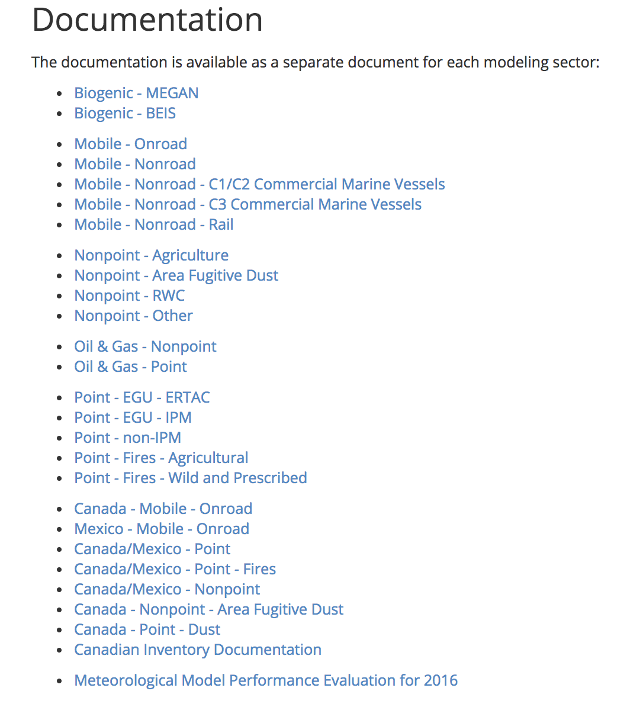
2016 v1 Release Documentation
Specification Sheets
27 documents in a standardized format
Describe the sector, the SCCs/sources included in the sector, data sources, processing methods
Graphical and tabular summaries of the data (IWDW, LADCO)
Canadian inventory and Meteorological performance also available

Slide 9
Items Not Yet Available
SMOKE-ready version of WRAP oil and gas inventories and ancillary data
Final specification sheets
Targeting posting to 2016v1 Wiki end of January: http://views.cira.colostate.edu/wiki/wiki/10202
AQM-ready merged emissions

Slide 10
Expected Applications of 2016v1
Some groups have stated plans to use the 2016v1 platform
LADCO
Regulatory modeling for haze and ozone
CAMx modeling: 12, 4, and 1.3 km domains
EPA
2016 annual CMAQ and CAMx at 12 and 36km resolution plus hemispheric CMAQ; fine scale modeling for selected domains
Sensitivity simulations for testing AQM configurations and evaluation
Northeast states
Regulatory modeling for ozone

Slide 11
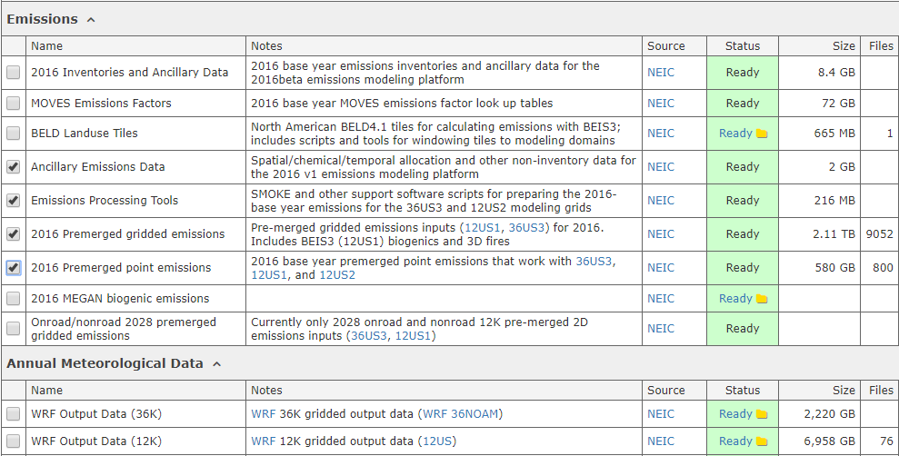
Requesting Modeling Platform Data from the IWDW
Browse to the IWDW Data Request Form: https://views.cira.colostate.edu/iwdw/RequestData
Choose a platform from the dropdown list
Check the components you want

Slide 12
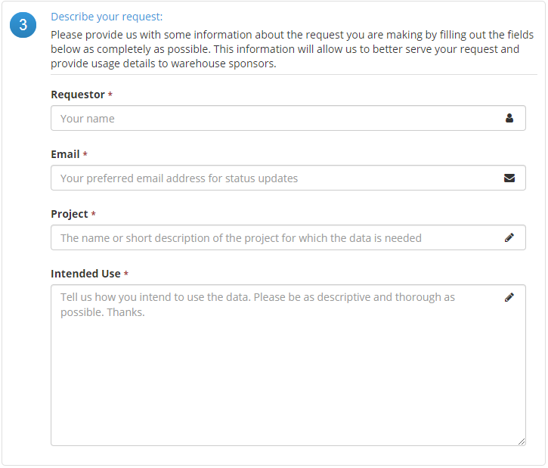
Requesting Modeling Platform Data from the IWDW

Slide 13
Requesting Modeling Platform Data from the IWDW
Accept our basic “data use” agreement
Submit your request

Slide 14
Some notes about the IWDW Data Request process
Response times can vary greatly for:
Non-sponsor platforms
Many requests will be filled the same day unless the request is for a modeling platform not funded by our sponsors (BLM, USFS, NPS) – in that case, priority must be given to sponsor-funded activities and data requests.
Very large volumes of data
Requests that involve very large volumes of data that cannot be easily serviced via SFTP must be manually shipped on physical hard drives.
SFTP is the preferred method of data transfer
In the case of requests that can be serviced online, the recommended method of data is the Secure File Transfer Protocol (SFTP)
Online transfer times can vary greatly
The outgoing connection from the IWDW is a high-bandwidth, high-speed fiber optic connection

Slide 15
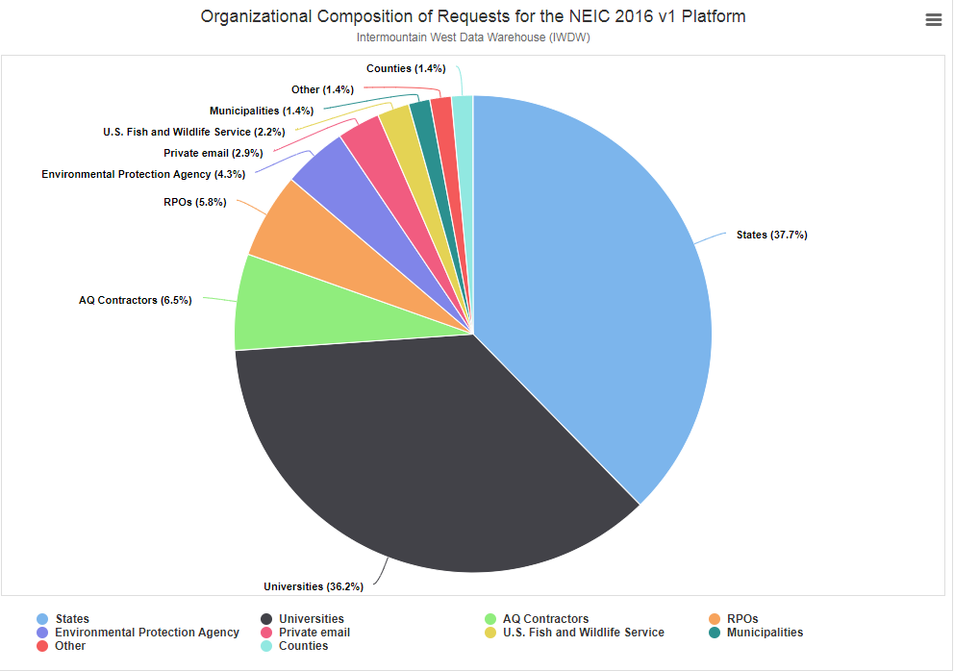
About 45 2016v1 requests have been made so far

Slide 16
Collaborative Workgroup Reports
EGUs
Non-EGU Point
Nonpoint
Oil and gas sources (point and nonpoint)
Onroad
Commercial Marine Vessels (CMV)
Nonroad
Rail
Biogenics
Fires
Modeling
Wiki has more information and notes from each workgroup
http://views.cira.colostate.edu/wiki/wiki/9169

Slide 17
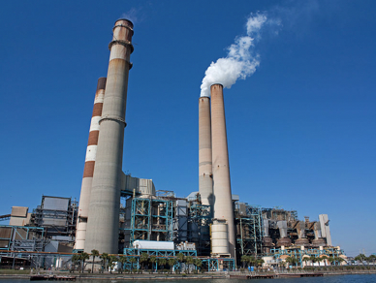
Electricity Generating Units (EGU) Workgroup
Co-leads: Julie McDill (retired), Susan McCusker (MARAMA), Serpil Kayin (EPA CAMD), Alison Eyth (EPA OAQPS)
Wiki: http://views.cira.colostate.edu/wiki/wiki/9174

Slide 18
EGU Workgroup: 2016 Base Year
Base Year Approach
Only a few updates from beta to v1
Comments received on beta
Data on NJ and Alaska EGUs
Updates to temporal profiles for some EGUs without CEMS in MARAMA states
Various comments from VA
Differences from beta
Base Year (2016): EGU emissions and temporal profiles updated to address as many comments as possible
A few sources moved from the non-EGU file to the EGU file
Projection Years: Updated versions of data for both ERTAC and IPM will be available

Slide 19
EGU Workgroup: IPM
EPA has updated its Power Sector Modeling Website with new IPM projections (IPM v6 May 2019 Reference Case)
Including NEEDS, incremental documentation and unit level results for 2023 and 2030
This version is included in 2016 v1 and includes
Additional closures and committed units
Adjustments to SO2 EFs for coal units
Updated methodology for PM post-processing
See https://www.epa.gov/airmarkets/clean-air-markets-power-sector-modeling
New NEEDS database posted 12/18/2019
https://www.epa.gov/airmarkets/national-electric-energy-data-system-needs-v6
EPA plans to continue quarterly updates

Slide 20
EGU Workgroup: ERTAC-EGU
Runs with new inputs of CONUS v16.1 draft final
Base year 2016; Future years 2020, 2023, 2028; others ?
Includes updates to v16.0 for 2016 v1: new CAMD data, hourly calculation methodology for base year
New updates for v16.1: Comments received from 36 states, hybrid growth approach (EIA AEO reference/high oil & gas cases)
CSAPR-compliant, generally meets state assurance levels
LADCO ERTAC model training video – coming soon!
Outreach to present v16.1 draft final results –
Jan 28 & 30, 2 pm EST
https://attendee.gotowebinar.com/register/1674355402062931970

Slide 21
EGU Workgroup: ERTAC-EGU
2016v1 ERTAC-EGU SMOKE processing package
NYDEC developed, LADCO & VA DEQ tested run scripts for “ERTAC platform package” SMOKE processing
One-page instructions + documentation
Future years in progress
Files together in one easy-to-swap parallel package
2016v1 IPM platform package includes:
2016v1 ERTAC platform package includes:
2016fh_16j/inputs/ptegu/
egucems_2016b + hourly temporalization
egunoncems_2016b
2016fh_16j/inputs/ptnonipm/
Nonegu_2016v1
2016fh_16j/inputs/ptertac
ERTACv16.0 + hourly temporalization
egunoncems_ERTACv16.0
2016fh_16j/inputs/ptnonertac
Nonegu_2016v1_ERTACv16.0

Slide 22
EGU Workgroup: ERTAC-EGU
ERTAC-EGU Next steps – Gearing up for v16.2
Continue workgroup calls to coordinate with EPA
Update growth rates - EIA AEO 2020 (annual); NERC 2019 Electricity Supply & Demand (peak)
Update shutdowns, controls, retirements – State input
Code upgrade to version 2.2
Bring in units that report to CAMD but are non-EGUs or burn non-fossil fuel
Process expected to start late Summer/early Fall 2020

Slide 23
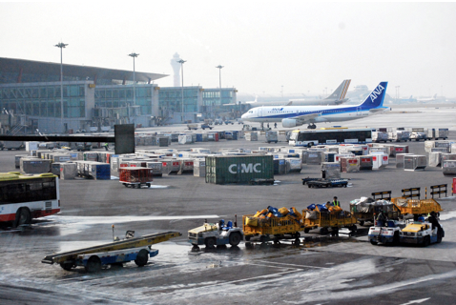
Non-EGU Point Workgroup
Co-leads: Tammy Manning (NC DEQ), Caroline Farkas (EPA)
Wiki: http://views.cira.colostate.edu/wiki/wiki/9177

Slide 24
Non-EGU Point: Base Year Updates
Differences from beta for non-EGU point
DC replacement inventory
Closures (VA, MA, NY), closures revoked in NC
GA anomalies
NJ applicable controls
MA State rules and Consent Decrees
Ethanol and biorefinery plants updated
Airports
Moved to a separate modeling sector
2017NEI aircraft emissions estimated using the FAA’s Aviation Environmental Design Tool (AEDT)
Major method changes between AEDT model (used for 2017 NEI airport emissions) and previously used model
Airport emissions back-casted from 2017 to 2016 using FAA historical data

Slide 25
Non-EGU Point: Future Year Updates
Differences from beta for non-EGU point
Industrial sources projected by SCC and SCC-NAICS using AEO 2019 data
MARAMA growth & control factors
Including MANEVU sulfur rules, NSPS (NG Turbines, RICE, Process heaters), State rules & consent decrees
Growth and control factor edits from beta submitted by states
NY, DC, MA, NJ, NC, NM, VA, WI
New impacted units for AZ Regional Haze
Consent Decrees reevaluated (removed those with compliance dates that have passed, added a few new units)
Ethanol and biorefinery plants projected
Airports
Projection factors created using airport-specific numbers from the FAA’s Terminal Area Forecast (TAF), where available – standard approach, new base emissions (see above)

Slide 26
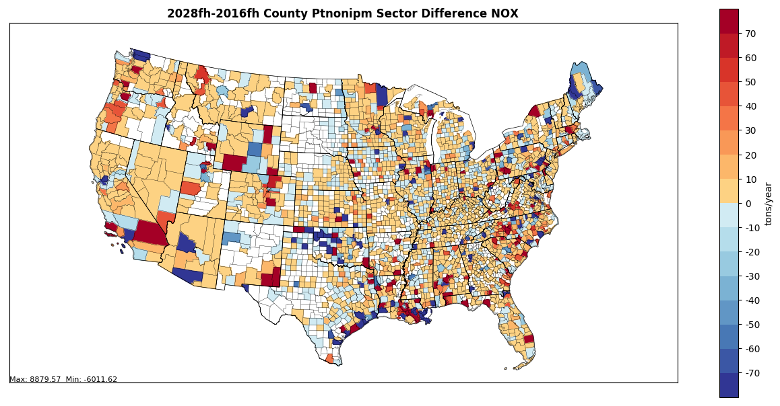
Non-EGU Point NOx Projection Differences
2028-2016v1

Slide 27
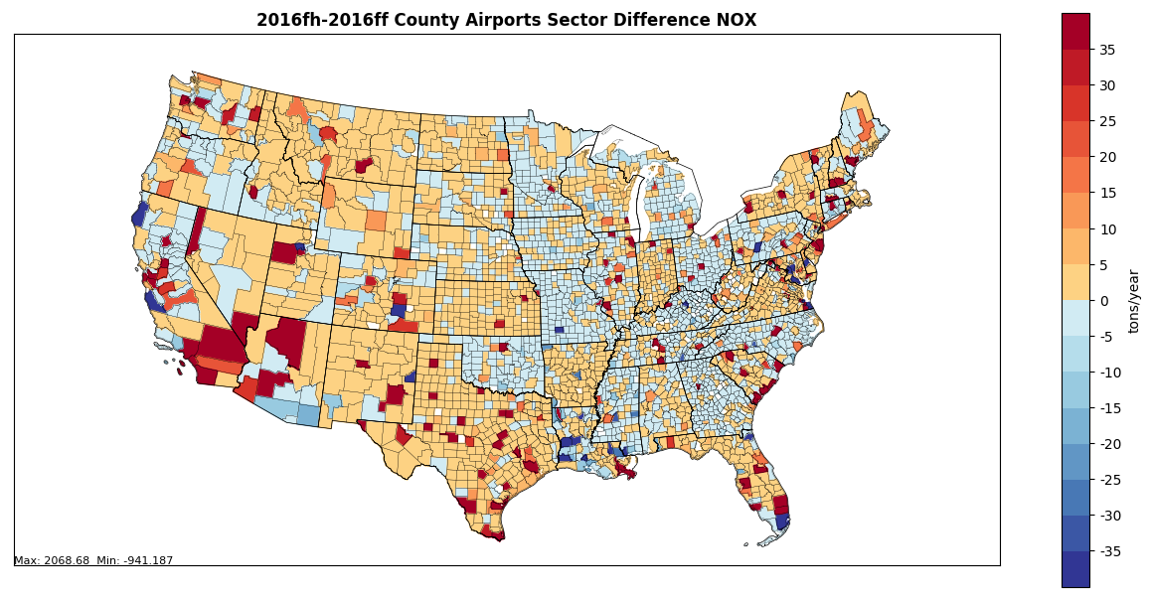
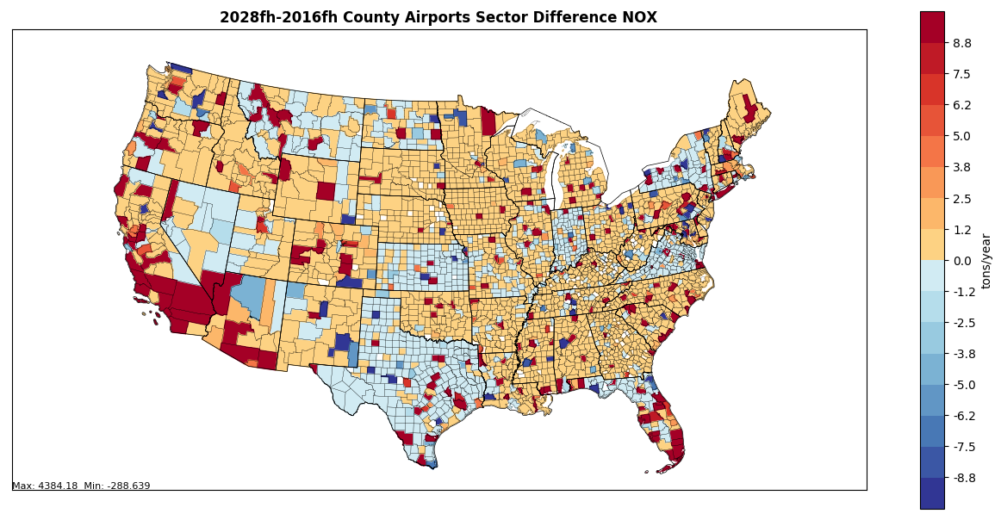
Airport NOx Difference Maps
2016v1-2016beta
2028-2016v1

Slide 28
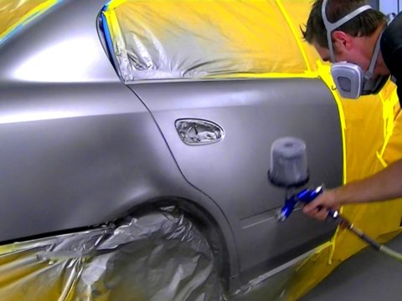
NonPoint Workgroup
Co-leads: Caroline Farkas (EPA), Jennifer Snyder (EPA)
Wiki: http://views.cira.colostate.edu/wiki/wiki/9178

Slide 29
NonPoint Workgroup: Base Year Updates
Differences from beta
Afdust: VMT for road dust updated to match onroad mobile VMT for 2016v1
Ag NH3:
New fertilizer application emissions for 2016
Livestock emissions are from 2017NEI backcasted to 2016 - corrects underprediction in dairy cows and poultry
Nonpoint-other:
Population-based activity data projected to 2016 using US Census data (e.g., consumer products, solvents, commercial cooking)
NC BoilerMACT controls and growth information

Slide 30
NonPoint Workgroup: Future Year Updates
Differences from beta
Afdust: State-submitted projection factors (MARAMA, NJ, NC)
Ag: livestock projected using Feb 2019 USDA national projections
RWC: VT & NC submitted new factors
Nonpoint-Other
Industrial sources updated to use Annual Energy Outlook (AEO) 2019
Control factors reevaluated (e.g., RICE NSPS, Boiler MACT, Fuel Sulfur rules, PA RACT)
Submitted edits included (MARAMA, NJ, NY, NC)
Cellulosic emissions included

Slide 31
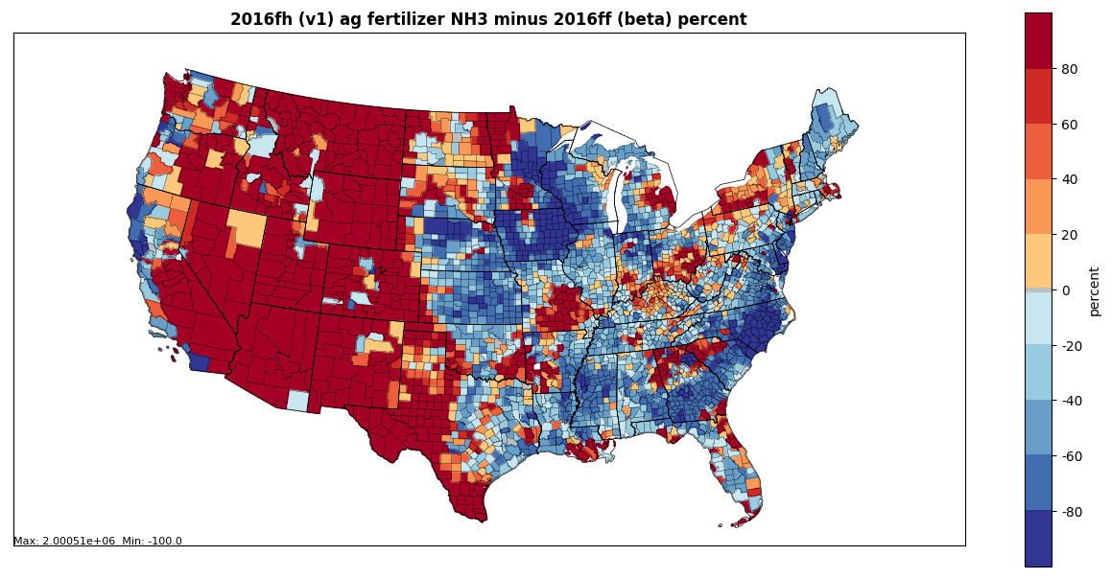
Ag Fert 2016fh (v1) NH3
Ag Fertilizer
New 2016 fertilizer emissions provided by EPA ORD
No growth assumed for projection years
2016v1-2016beta
Most larger increases
in areas with low emissions
NH₃ % Difference

Slide 32
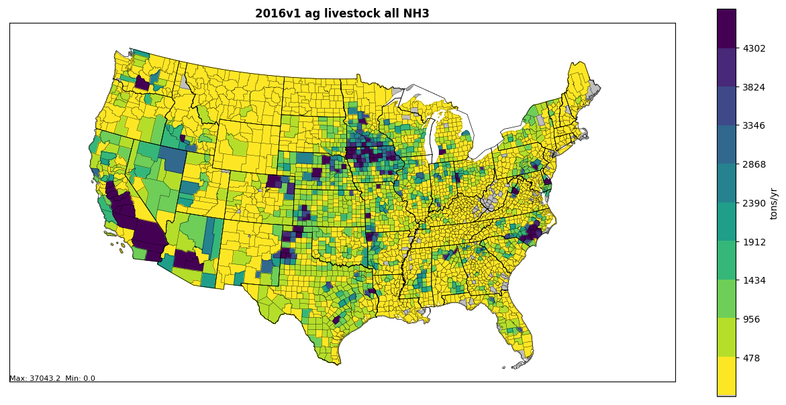
Ag Livestock
2016v1 emissions based on 2017 NEI
Poultry (layers) and Dairy cattle are largest increases
2016v1-2016beta
NH₃ % Difference

Slide 33
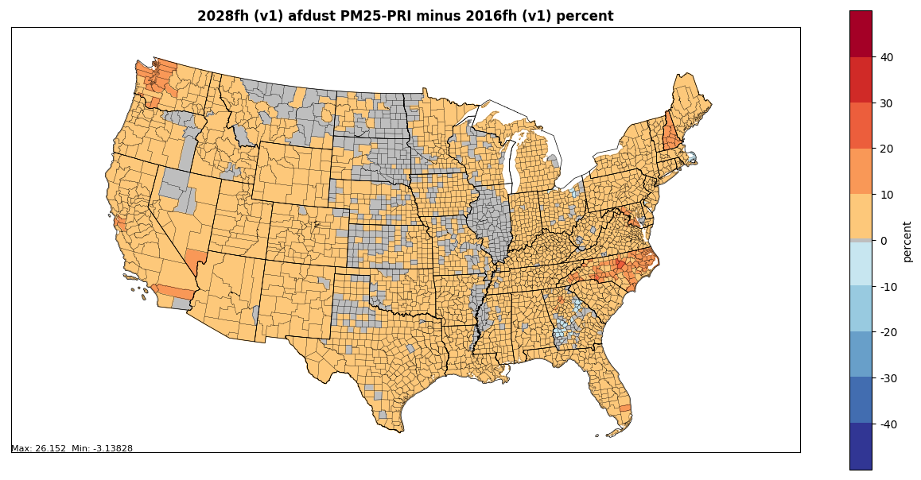
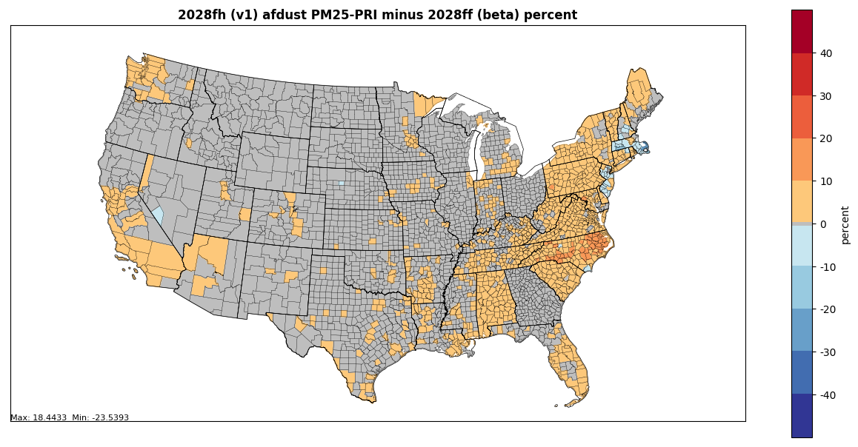
Afdust PM_{2.5}
% Difference Maps
Largest increases in projected emissions are from paved roads fugitive dust and crop tilling
Changes in MARAMA states are from updated growth packets for v1
2028-2016v1
2028_{v1}-2028_{beta}

Slide 34
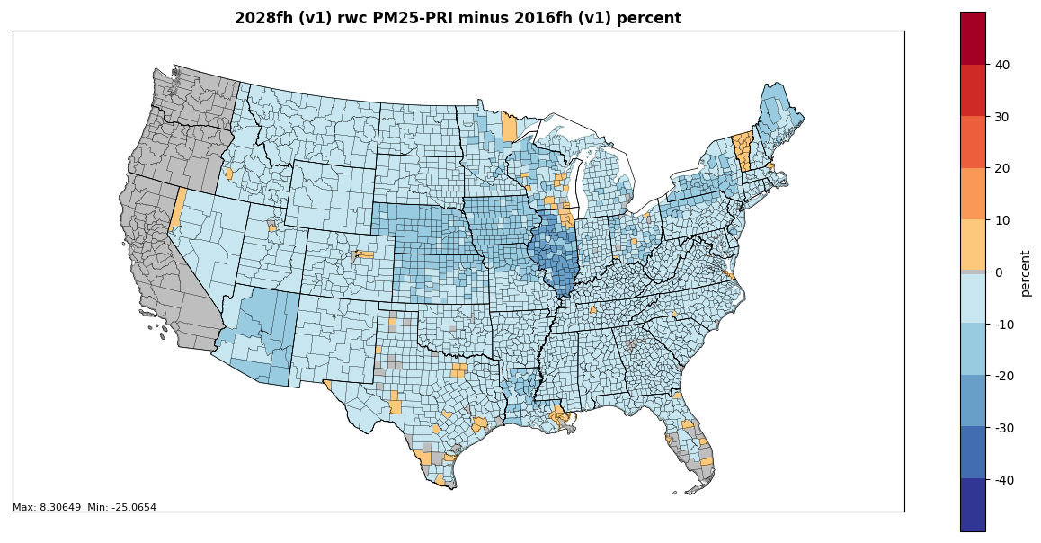
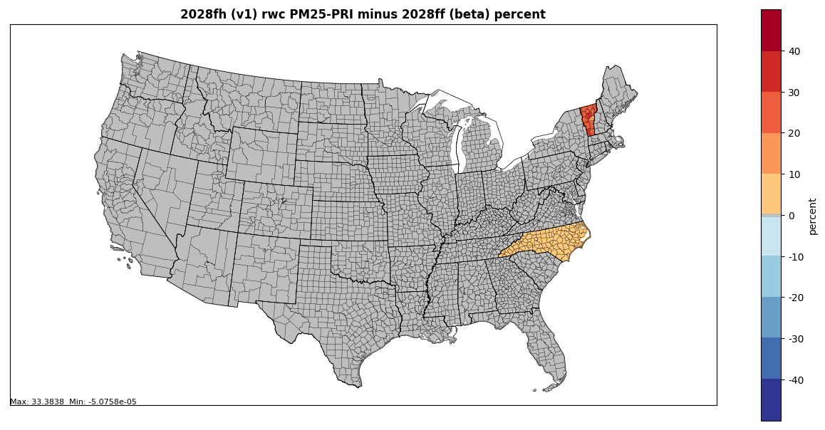
RWC PM_{2.5}
% Difference Maps
VT and NC submitted edits for v1
CA, OR, WA have no growth for future year scenarios
Largest decreases in projections are from indoor wood non-EPA certified furnaces
2028-2016v1
2028_{v1}-2028_{beta}

Slide 35
Oil and Gas Workgroup
Co-leads: Jeff Vukovich (EPA), Tom Richardson (OK DEQ)
Venue for Future Work: National Oil & Gas Emissions Committee (NOGEC) – Calls on 2nd Thursday at 2pm Eastern, Contact: michael.ege@tceq.texas.gov
Wiki: http://views.cira.colostate.edu/wiki/wiki/9180
Status: Version 1 Work Completed

Slide 36
Oil and Gas Emissions Workgroup
2016 Base year emissions for Version 1
Point SCCs: used 2016 AERR submissions for all AERR Type A sources and for Type B sources where available. (Grew 2014 NEI Version 2 emissions for Type B sources as needed.)
Nonpoint production and exploration sources: used an updated version of the EPA Oil and Gas Emissions Inventory Tool with 2016 activity data. (Some states supplied alternative approaches.)

Slide 37
Oil and Gas Emissions Workgroup
Comments Received on the Beta Platform and Adjustments Made for Version 1
Updated PA and IL non-point base year inventory
Pennsylvania provided unconventional well-related emissions
EPA O&G tool used for conventional well-related emissions
Impact: NOx up 16K tons and VOC down 56K tons
Illinois provided updated active well information
48K active wells in 2016beta but actual active wells about 20K
Impact: NOx down 14K tons and VOC down 48K tons
Virginia provided new 2016 Natural Gas transmission point source emissions
Improved future-year projections (discussed later)
Incorporated state/MJO updates (although the WESTAR/WRAP updates are a work in progress)

Slide 38
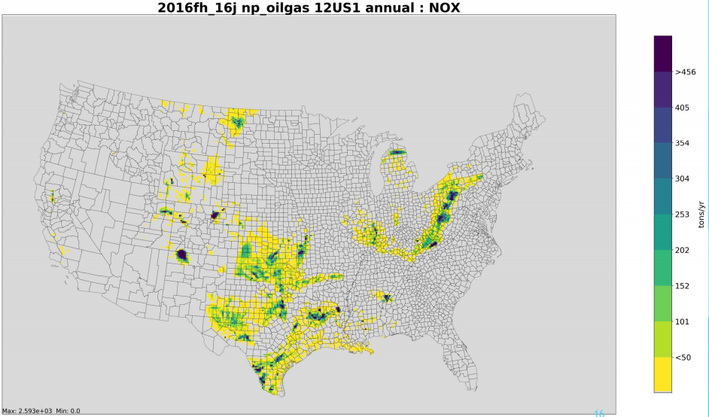
Base Year (2016) Nonpoint NOx Emissions

Slide 39
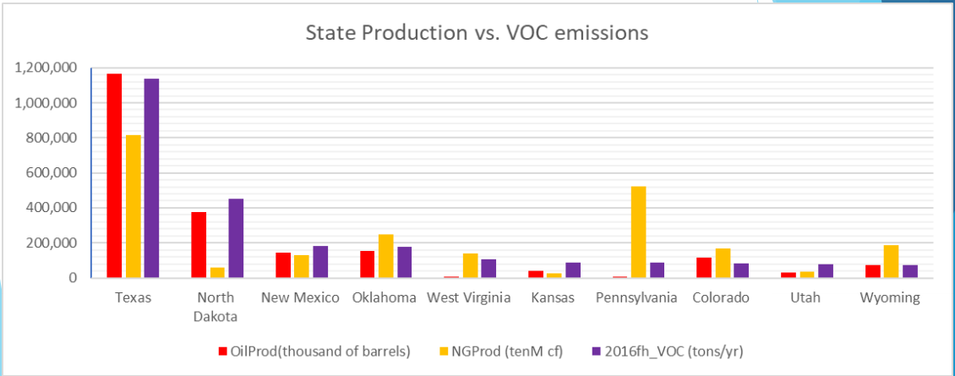
EIA State Production vs. VOC Emissions (2016v1)

Slide 40
Oil and Gas Emissions Workgroup
Future-year projections for Version 1
Growth for point and nonpoint production-related sources (SCCs in nonpoint and NAICS in point sources): used AEO2019 reference case
Nonpoint exploration sources: Used 4-year average (2014-2017) emissions dataset (no growth)
Added NJ control information for pipeline compressor(s).
Used VA natural gas transmissions future year emissions.
Applied controls for future-year activity increases and for equipment turnover (e.g., diesel engines on drilling rigs).

Slide 41
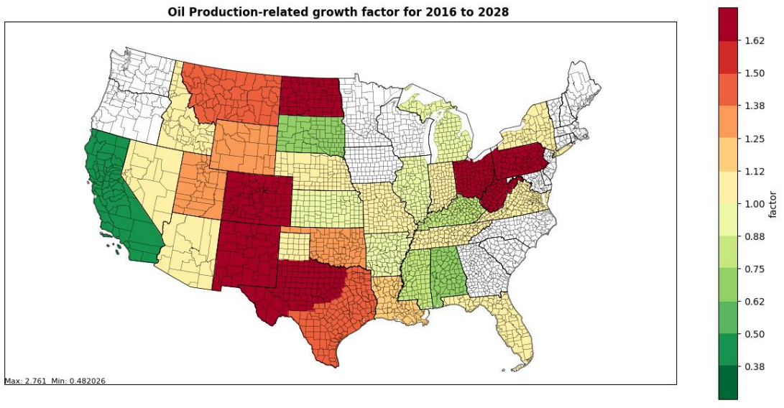
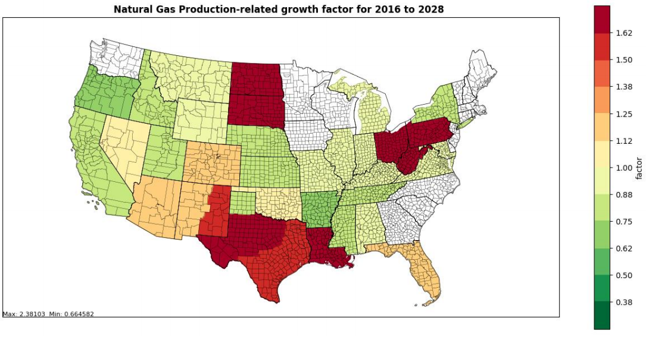
Crude Oil and Natural Gas Production Growth Factors (2016 EMP Version 1)
Increase
Oil
Decrease
Natural Gas

Slide 42
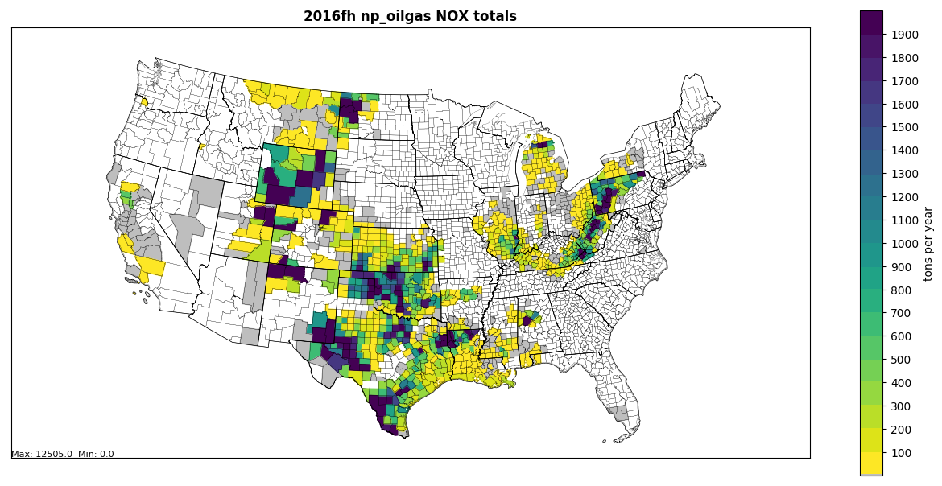
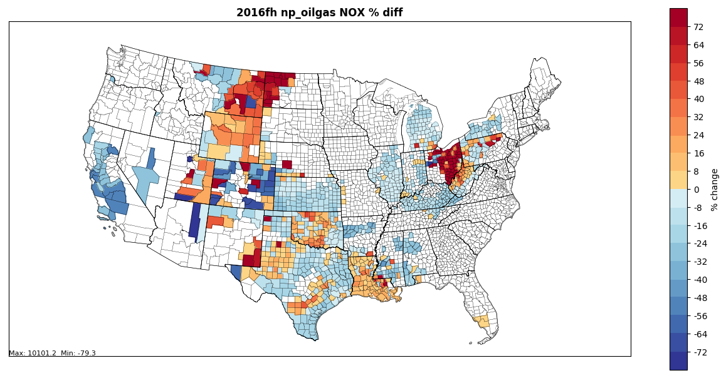
2016 version 1
Nonpoint oil and
gas NOx (tons/yr)
2028 – 2016 NOx
% change in
nonpoint oil and gas emissions

Slide 43
Oil and Gas Emissions Workgroup
Make WESTAR/WRAP oil and gas emissions available with the platform
Compare 2016v1 oil and gas emissions with the 2017 NEI
Ongoing efforts to improve the inventory
Capture efficiency and control efficiency for tanks
Missing sources
Additional improvements (top-down vs. bottom-up reconciliation, etc.)
Continuing evaluation of projections
Forecasting exploration activity
Incorporating decline curves into the growth and control approach

Slide 44
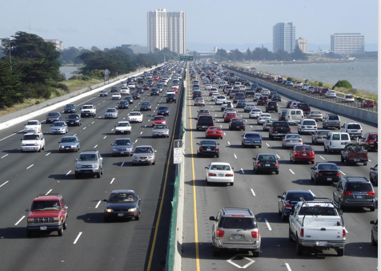
Onroad Mobile Workgroup
Co-leads: Julie McDill (retired) and Debbie Wilson (MARAMA), Alison Eyth (EPA OAQPS)
Wiki: http://views.cira.colostate.edu/wiki/wiki/9181

Slide 45
Onroad Workgroup: 2016v1
Differences from beta (see September presentation for more info)
Incorporated new state-supplied MOVES input data
Activity data (VMT and VPOP) were updated for states that provided new data for 2016v1
Hoteling hours were reduced based on new information
Vehicle age distributions were updated to represent 2016 based on CRC A-115 VIN decode project for 2017 NEI
Representative counties were updated to reflect new data
MOVES was run with updated inputs to create new emission factors for 2106, 2020, 2023, and 2028
VMT projection factors updated to use AEO 2019
SMOKE-MOVES was run using the new emission factors with updated activity to create emissions
SMOKE-MOVES now uses average speed distributions; and gridded hourly met for NOx adjustments

Slide 46
2016v1 Platform CONUS Onroad Emissions Compared to 2016beta
ff = beta fh = v1
poll | 2016v1 | 2023v1 | 2028v1 | 2016v1/ 2016beta | 2023v1/ 2023beta | 2028v1/ 2028beta
CO | 19,889,617 | 13,773,993 | 10,308,234 | 0.98 | 0.97 | 0.99
NH3 | 100,318 | 89,285 | 87,913 | 0.99 | 1.02 | 1.05
NOX | 3,630,548 | 1,750,937 | 1,246,019 | 0.89 | 0.90 | 0.92
PM10-PRI | 239,997 | 199,979 | 189,838 | 0.88 | 0.89 | 0.90
PM25-PRI | 117,758 | 72,468 | 58,925 | 0.90 | 0.92 | 0.93
SO2 | 27,559 | 12,484 | 11,703 | 1.00 | 1.01 | 1.01
VOC | 1,852,260 | 1,098,966 | 836,112 | 0.93 | 0.92 | 0.94
Notes:
2016 NOx is about 10% lower, VOC about 7% lower, PM 12% lower

Slide 47
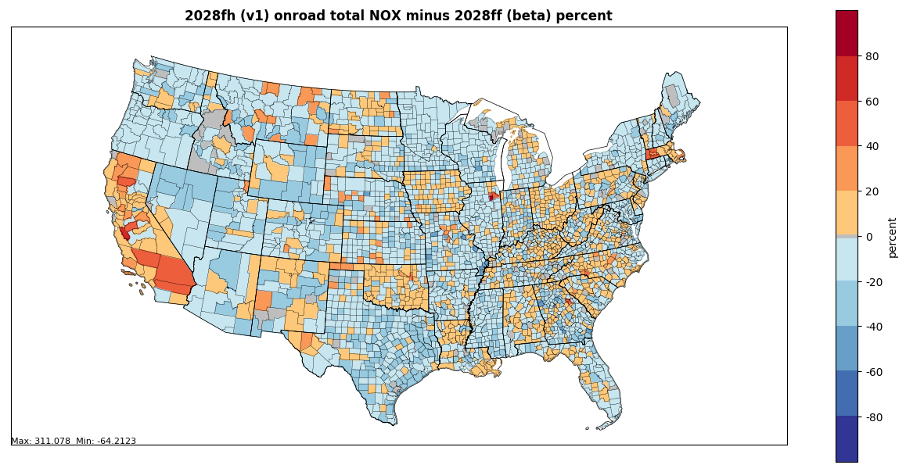
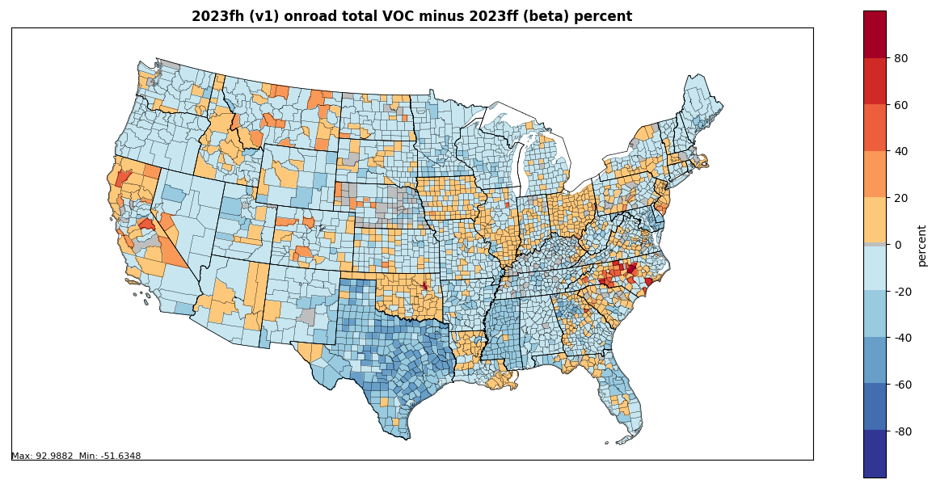
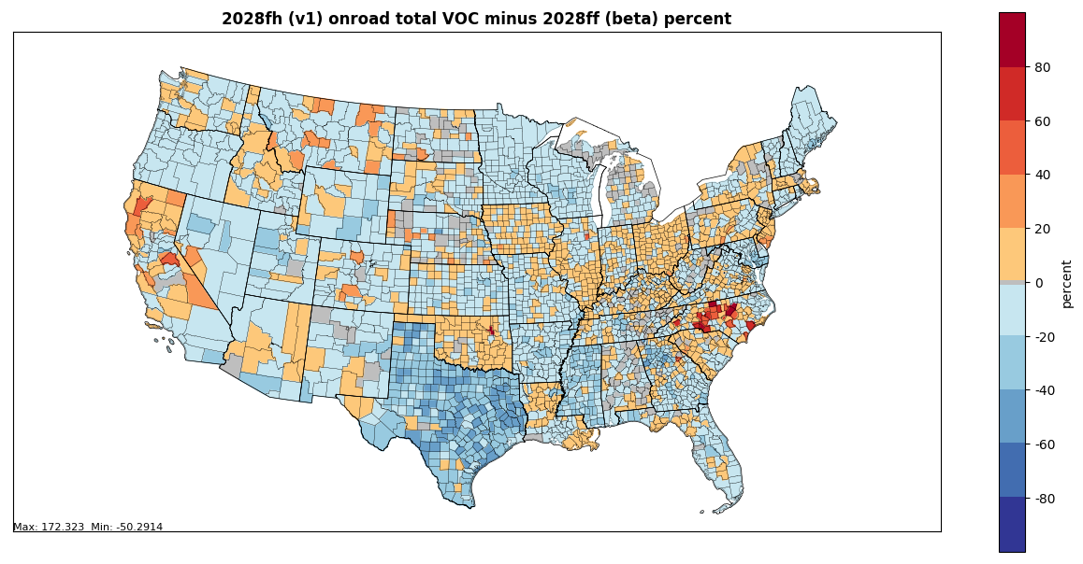
% Differences: v1 minus beta
2023 onroad NOx v1 minus beta
2028 onroad NOx v1 minus beta
2023 onroad VOC v1 minus beta
2028 onroad VOC v1 minus beta

Slide 48
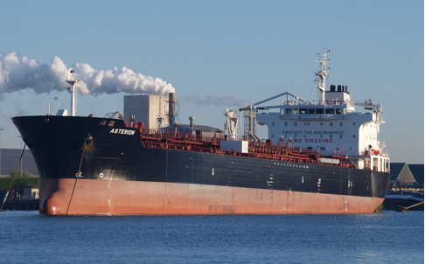
Commercial Marine Vessel (CMV) Workgroup
Lead Mark Janssen (LADCO); updates provided by EPA OAQPS
Wiki: http://views.cira.colostate.edu/wiki/wiki/9176
48

Slide 49
Marine Workgroup: 2016v1 Summary
For C3 and C1C2, AIS-based hourly emissions data files for each day were generated for rasterization
Rasterized C3 and C1C2 onto 36-km and 12-km gridded (hourly) data for CONUS
During this process, adjusted 2017 inventory to 2016
Reconciled C3 and C1/C2 with Canadian CMV inventory
Gapfilled portions of 36km domain not covered by AIS data selection (small portions of AK, HI, St. Lawrence Seaway)
Prepared CMV input data for SMOKE on grids that cover Alaska, Hawaii, Puerto Rico + Virgin Islands, Great Lakes, and Long Island Sound

Slide 50
CMV Updates Since September
The first version of the 2016v1 C1C2 and C3 CMV inventories was released in September
Some anomalies were found as EPA prepared to use the data
Some days and locations had particularly high values
Many of the high values were from data being aggregated to a single time step when ships were stationary (aka “hoteling”)
The data were scanned and a report on times and locations where hoteling exceeded one hour was generated
A program was developed to read the report and spread the hoteling emission out over the period of the hoteling
Emissions were truncated if hoteling was > 400 hours
The hoteling adjustment program was applied to both cmv_c1c2 and cmv_c3 inventories

Slide 51
Additional CMV Updates
A day-of-week pattern was noticed in the NY/NJ area
The original 2016 emissions did not consider day of week when they were developed from the 2017 activity data
A mapping of 2016 days of the year to 2017 days was developed where day of the week in 2016 matched the same day of week in 2017, as well as lining up holidays (e.g., Memorial Day)
A program was used to recreate the 2016 CMV emissions using the specified 2017 days
The new CMV inventories for base and future years, along with updated scripts will be posted this month:
ftp://newftp.epa.gov/air/emismod/2016/v1/
SMOKE outputs will be transferred to IWDW once available

Slide 52
CMV C3 Annual Total NOx Emissions

Slide 53
CMV C1C2 Annual Total NOx Emissions

Slide 54
Difference between 2016v1 and 2016beta CMV Annual NOx Emissions

Slide 55
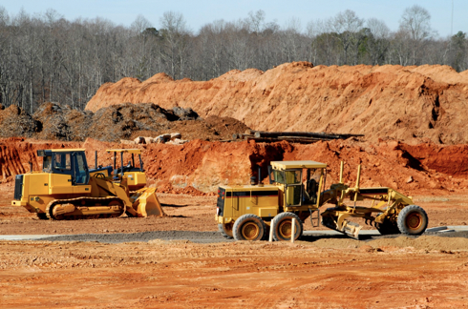
Nonroad Mobile Workgroup
Lead: Sarah Roberts (EPA OTAQ)
Wiki: http://views.cira.colostate.edu/wiki/wiki/9179
Milestones:
Addressed comments received on the 2016beta nonroad inventory
v1 base and future year nonroad inventories complete
Nonroad documentation available on 2016v1 EMP wiki

Slide 56
Nonroad Workgroup: 2016v1
Comments received on 2016beta nonroad inventory
Georgia Department of Natural Resources: incorporate updated fuel supply for 45 Georgia counties, to reflect the removal of summer Reid Vapor Pressure restrictions in 2016; utilize updated geographic allocation factors for the Commercial, Lawn & Garden, Logging, Manufacturing, Golf Carts, Recreational, Railroad Maintenance Equipment and A/C/Refrigeration equipment sectors
Lake Michigan Air Directors Consortium: update seasonal allocation of agricultural equipment activity for Illinois, Indiana, Iowa, Michigan, Minnesota, Missouri, Ohio, and Wisconsin.
Texas Commission on Environmental Quality: replace MOVES2014b nonroad emissions for Texas with emissions calculated with TCEQ’s TexN2 model.
Alaska Department of Environmental Conservation: remove emissions as calculated by MOVES2014b for several equipment sector-county/census areas combinations in Alaska, due to an absence of nonroad activity.

Slide 57
Nonroad Workgroup: 2016v1
Approach
Ran MOVES2014b for 2016, 2023, and 2028 with state-supplied data and updated factors for allocating Agricultural and Construction equipment
MOVES2014b nonroad inventories for Texas and California replaced with inventories provided by TCEQ and CARB
MOVES Run Setup
Reviewed data submitted for 2017 NEI and incorporated into 2016v1 where appropriate, for example:
Month and spatial allocations of snowmobiles in UT
Recreational marine allocations in WA
Updated equipment populations in Maricopa County (AZ), UT, CT
Updated Agricultural and Construction equipment allocations to the state- and county-level (Work Group update)
Updated fuel supply and equipment allocations in GA
Temporal (month) profiles for Agricultural equipment activity in LADCO states

Slide 58
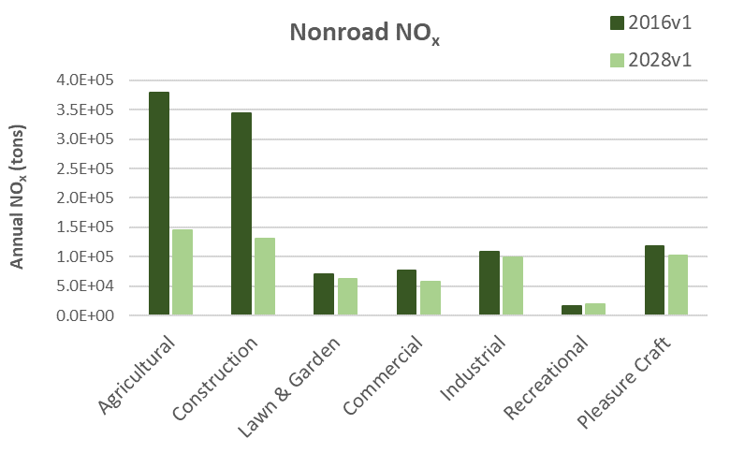
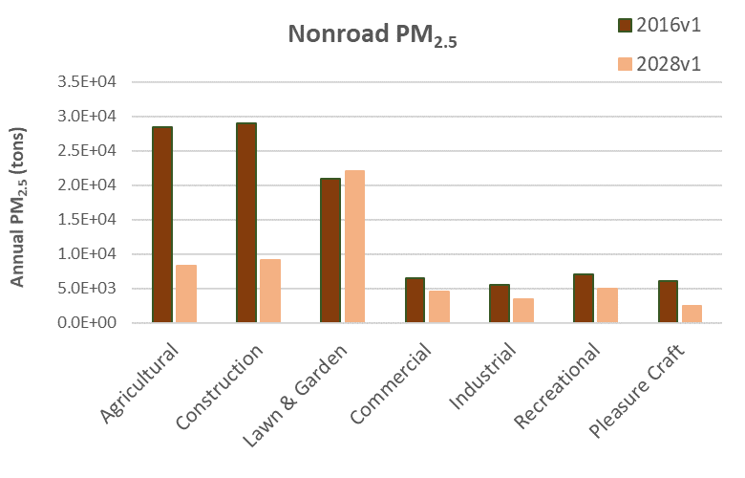
Nonroad Workgroup: 2016v1
-61.6%
Declines in emissions from 2016 to 2028 are the result of equipment turnover → newer, cleaner engines will dominate the market in future years
-61.9%
-9.2%
-13.6%
-10.5%
-25.8%
+21.5%
Nonroad engine regulations driving emissions reductions
Tier 4 standards for nonroad diesel engines (starts in 2008)
Emission standards for new nonroad spark-ignition engines, equipment, and vessels (starts in 2010)
-70.6%
-68.8%
+5.0%
-30.2%
-37.9%
-30.4%
-59.2%

Slide 59
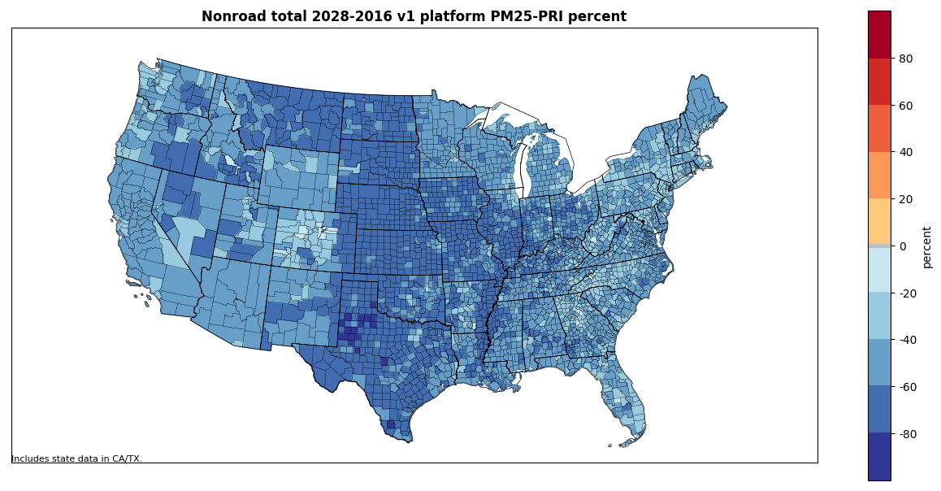
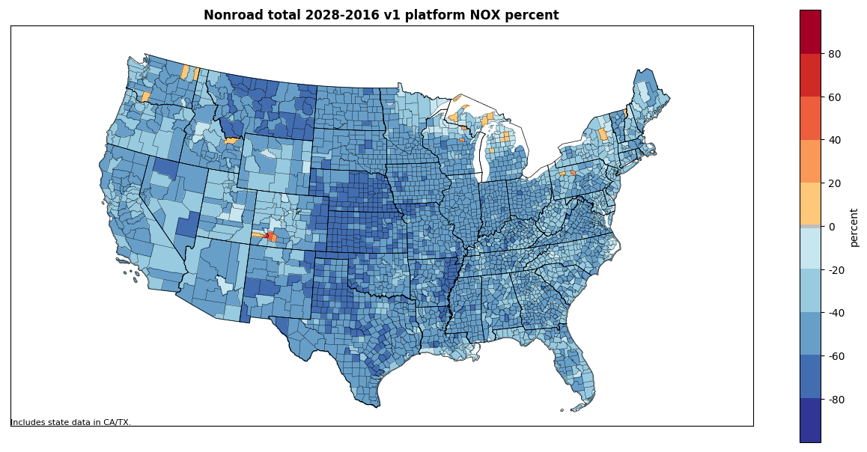
Nonroad % Differences: 2028-2016v1
National Summary
Pollutant | % difference (2028-2016)
NO_{x} | -44.8%
VOC | -28.9%
PM_{2.5} | -47.1%
PM₁₀ | -46.3%
SO₂ | -27.7%
CO | +2.9%
PM_{2.5}
NOx

Slide 60
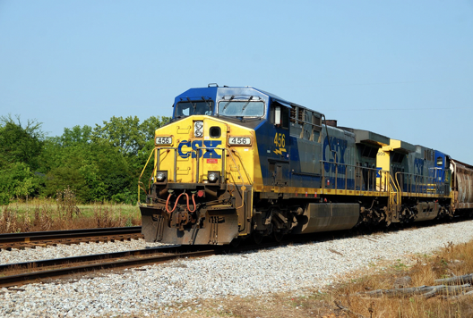
Rail Workgroup
Lead Mark Janssen (LADCO)
Wiki: http://views.cira.colostate.edu/wiki/wiki/9182

Slide 61
Rail Workgroup: 2016v1
Approach
Incorporated comments from states
Updated growth rates based on new AEO projections
Include better growth estimates of fleet technology
Differences from beta
Fixed inventory spreadsheets

Slide 62
Projection Methodology Overview
Started with Energy Information Administration’s Annual Energy Outlook (AEO) freight rail energy use growth rate projections for 2016 to 2050.
Added in a correction factor for 2017 to account for the abnormally low amount of Class I line-haul fuel use in 2016.
Used modified AEO growth rates to project Class I line-haul fuel use for 2020, 2023, 2028.
Used 2007, 2014, 2016, and 2017 Class I fleet mix data to create projected Emission Factor trendlines for NOx, PM10, and HC.
Determined future year Emission Factor estimates for 2020, 2023, and 2028.
Used 2016 FRA MGT data, Adjusted RFCI values, and EF estimates to create future year link, state, and county emission estimates for 2020, 2023, 2028.

Slide 63
Rail Workgroup: 2016v1

Slide 64
Line Haul Projection Results
Notes:
2028 NOx is 361,914 tons

Slide 65
Biogenic Workgroup
Co-leads: Doug Boyer (TCEQ), Jeff Vukovich (EPA)
Wiki: http://views.cira.colostate.edu/wiki/wiki/9172

Slide 66
Biogenic Emissions Workgroup
Summary
Used Environment Canada’s Biogenic Emissions Landcover Database version 4 (BELD4) 1km resolution dataset to update landuse for their country
Only able to update landuse for Biogenic Emissions Inventory System version (BEIS3)
No changes for Model of Emissions of Gases and Aerosols from Nature (MEGAN3) version 3 for 2016v1
Differences from beta
For Canada, the 17 MODIS landuse types were replaced by 92 different BELD4 landuse types from Environment Canada
Canadian landuse changes resulted in significant changes in VOC emissions and some impact on biogenic NOx emissions
Status: Released

Slide 67
Biogenic Emissions Workgroup
Other related activities
MEGANv3.1 recently released
Fixes bugs identified in MEGANv3.0
EPA ORD working on a new version of BELD (BELD version 5)
Quality assurance phase has begun
Ongoing evaluation of both biogenic emissions models for summer 2013 using observed emissions flux data available for this time period

Slide 68
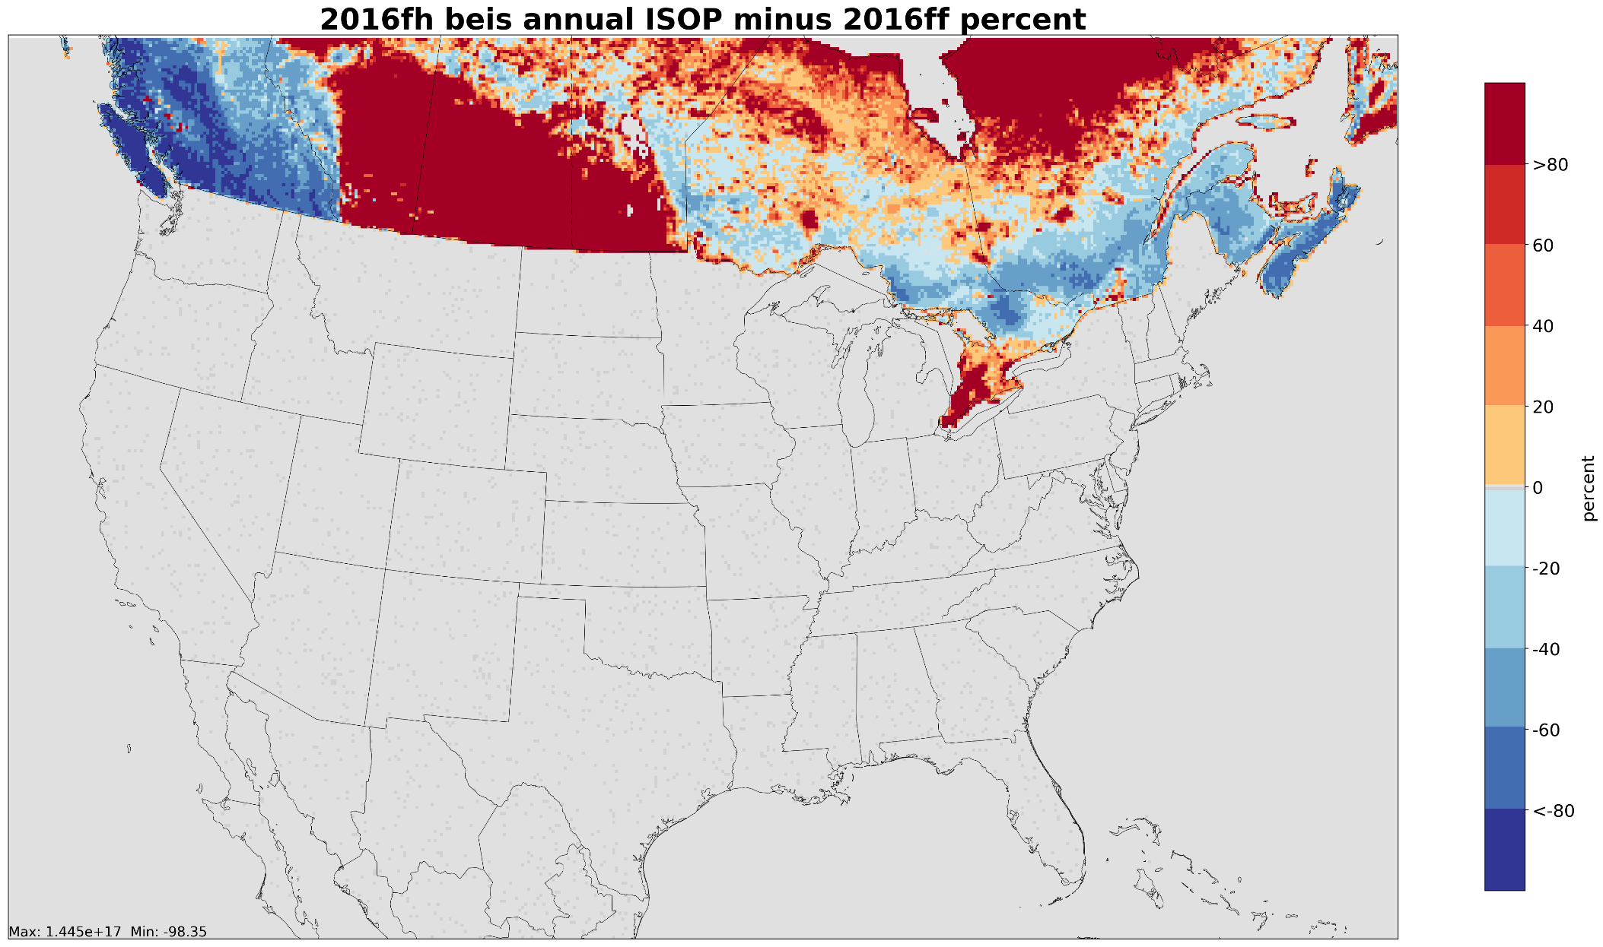
Percent difference changes for Isoprene: 2016v1 – 2016beta
Notes:
Significant increase in biogenic VOC in ag belt area just north of MT and Dakotas. Also increase in north Ontario and Quebec provinces. Decreases in British Columbia (west) and in parts of southeastern Canada along US border.

Slide 69
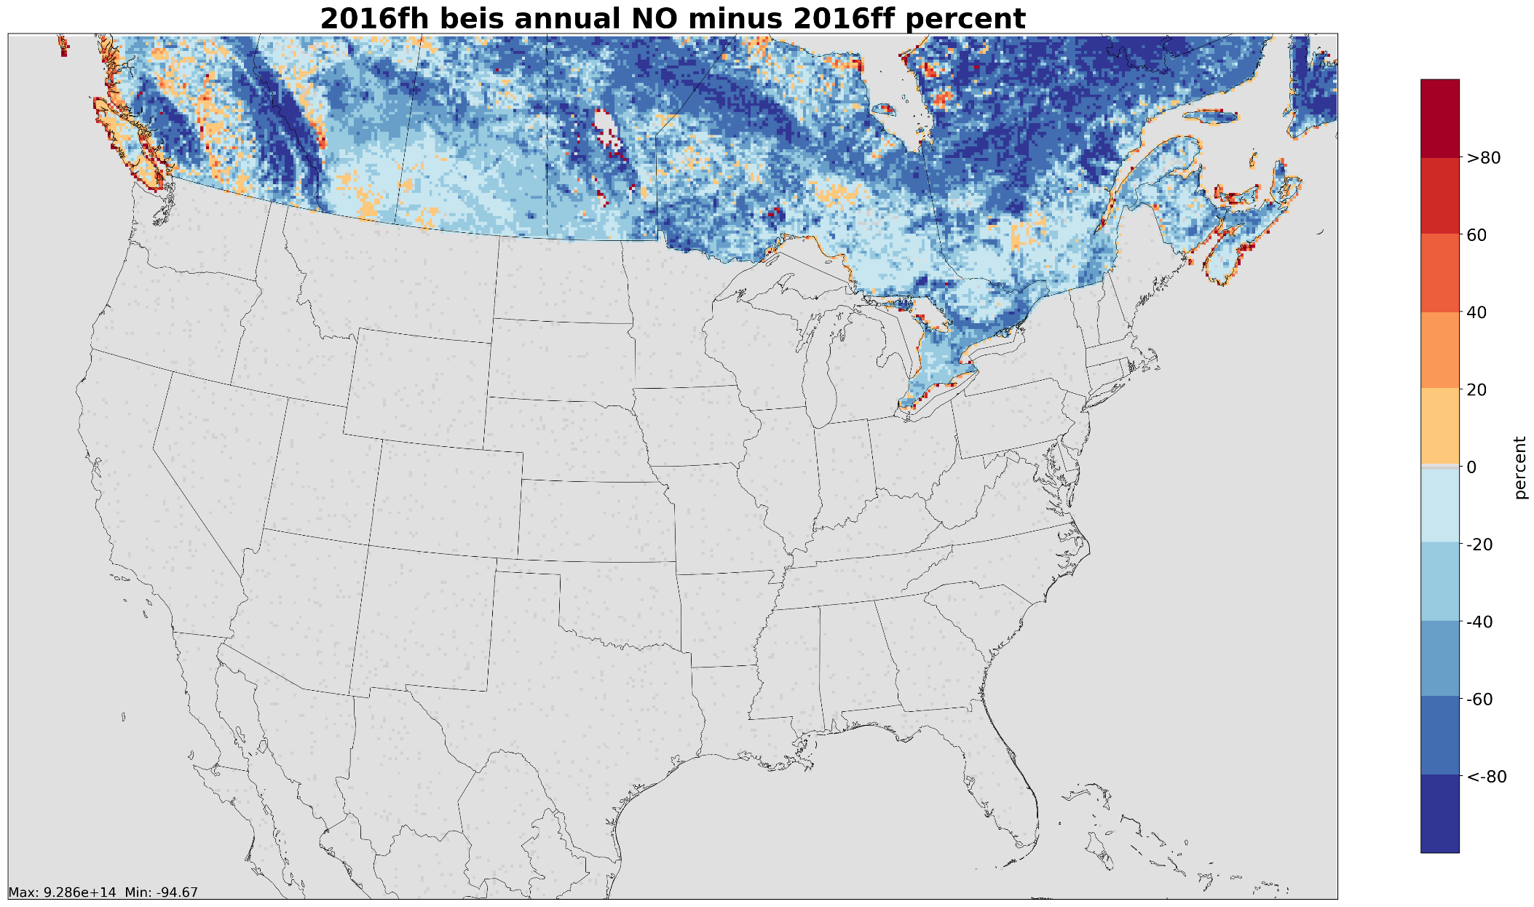
Percent difference changes for Nitric Oxide: 2016v1 – 2016beta
Notes:
Decrease in NOx just about everywhere in Canada. Env Canada landuse has less ag than MODIS landuse and the more specific tree types in Env Canada dataset just have lower emission factors than the MODIS landuse types.

Slide 70
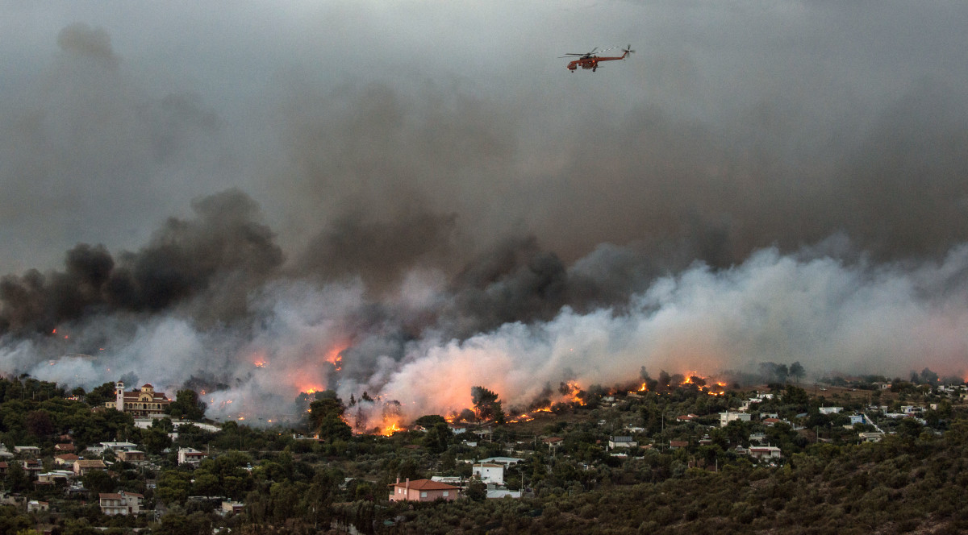
Fires Workgroup
Co-leads: Jeff Vukovich (EPA)
Wiki: http://views.cira.colostate.edu/wiki/wiki/9175
Includes wildfires, prescribed fires and agricultural burns

Slide 71
Fires Emissions Workgroup
Summary of 2016v1
Implemented newly acquired Fire information databases
US Forest Service FACTS: prescribed burns [shapefiles]
US Fish and Wildland Service (USFWS): wildfire and Rx
New Jersey: wildfire and prescribed
Georgia: day-specific ag burns (beta used month-specific)
Cleaned up obvious duplicate and bad fire information
Differences from beta
Overall wildfire and prescribed burn acres burned up from 17M acres (beta) to 17.1M acres
Prescribed acres burned up from 11.4M (beta) to 11.9M
Wildfire acres burned down from 5.61M (beta) to 5.2M
Deleted bad or duplicate fire information for major wildfires
Largest changes in acres burned are in CA, CO, SD, and OR

Slide 72
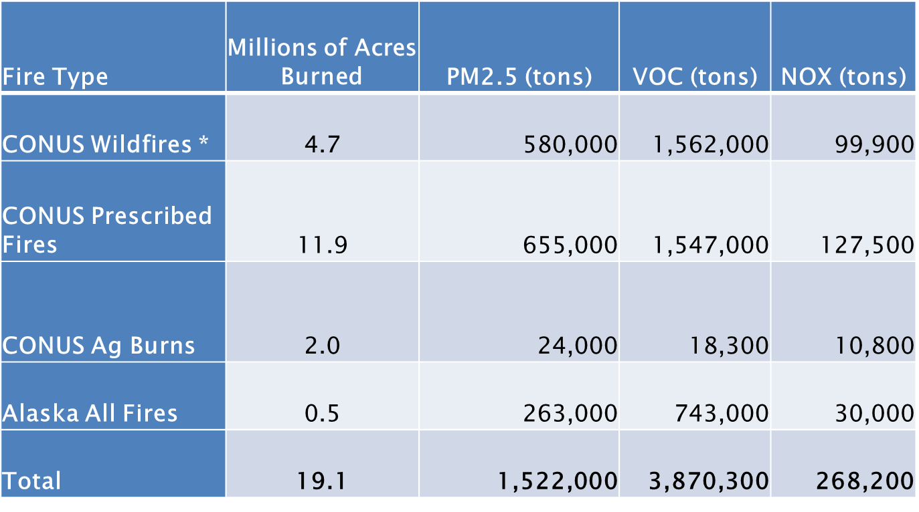
Fires Emissions Workgroup
Milestones
2016v1 RELEASED

Slide 73
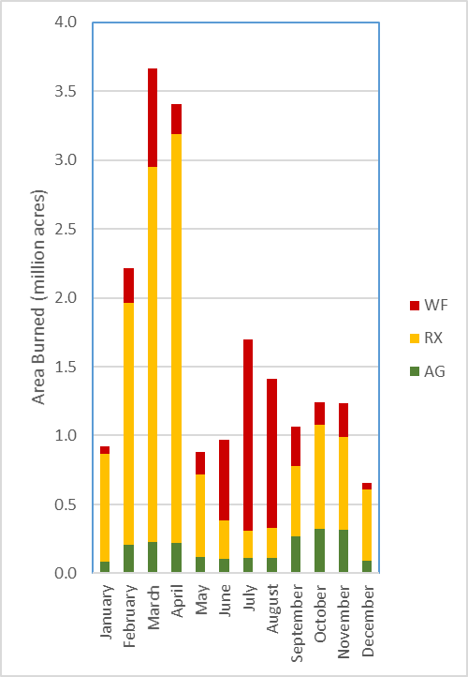
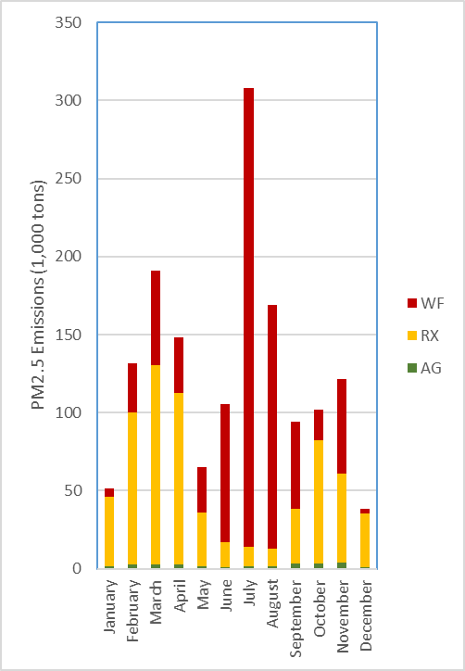
Results: U.S. Type Monthly
Notes:
July has a huge amount of PM because it has a lot of wildfires and they are in forests. March has more total acres, but they are prescribed grass burns.

Slide 74
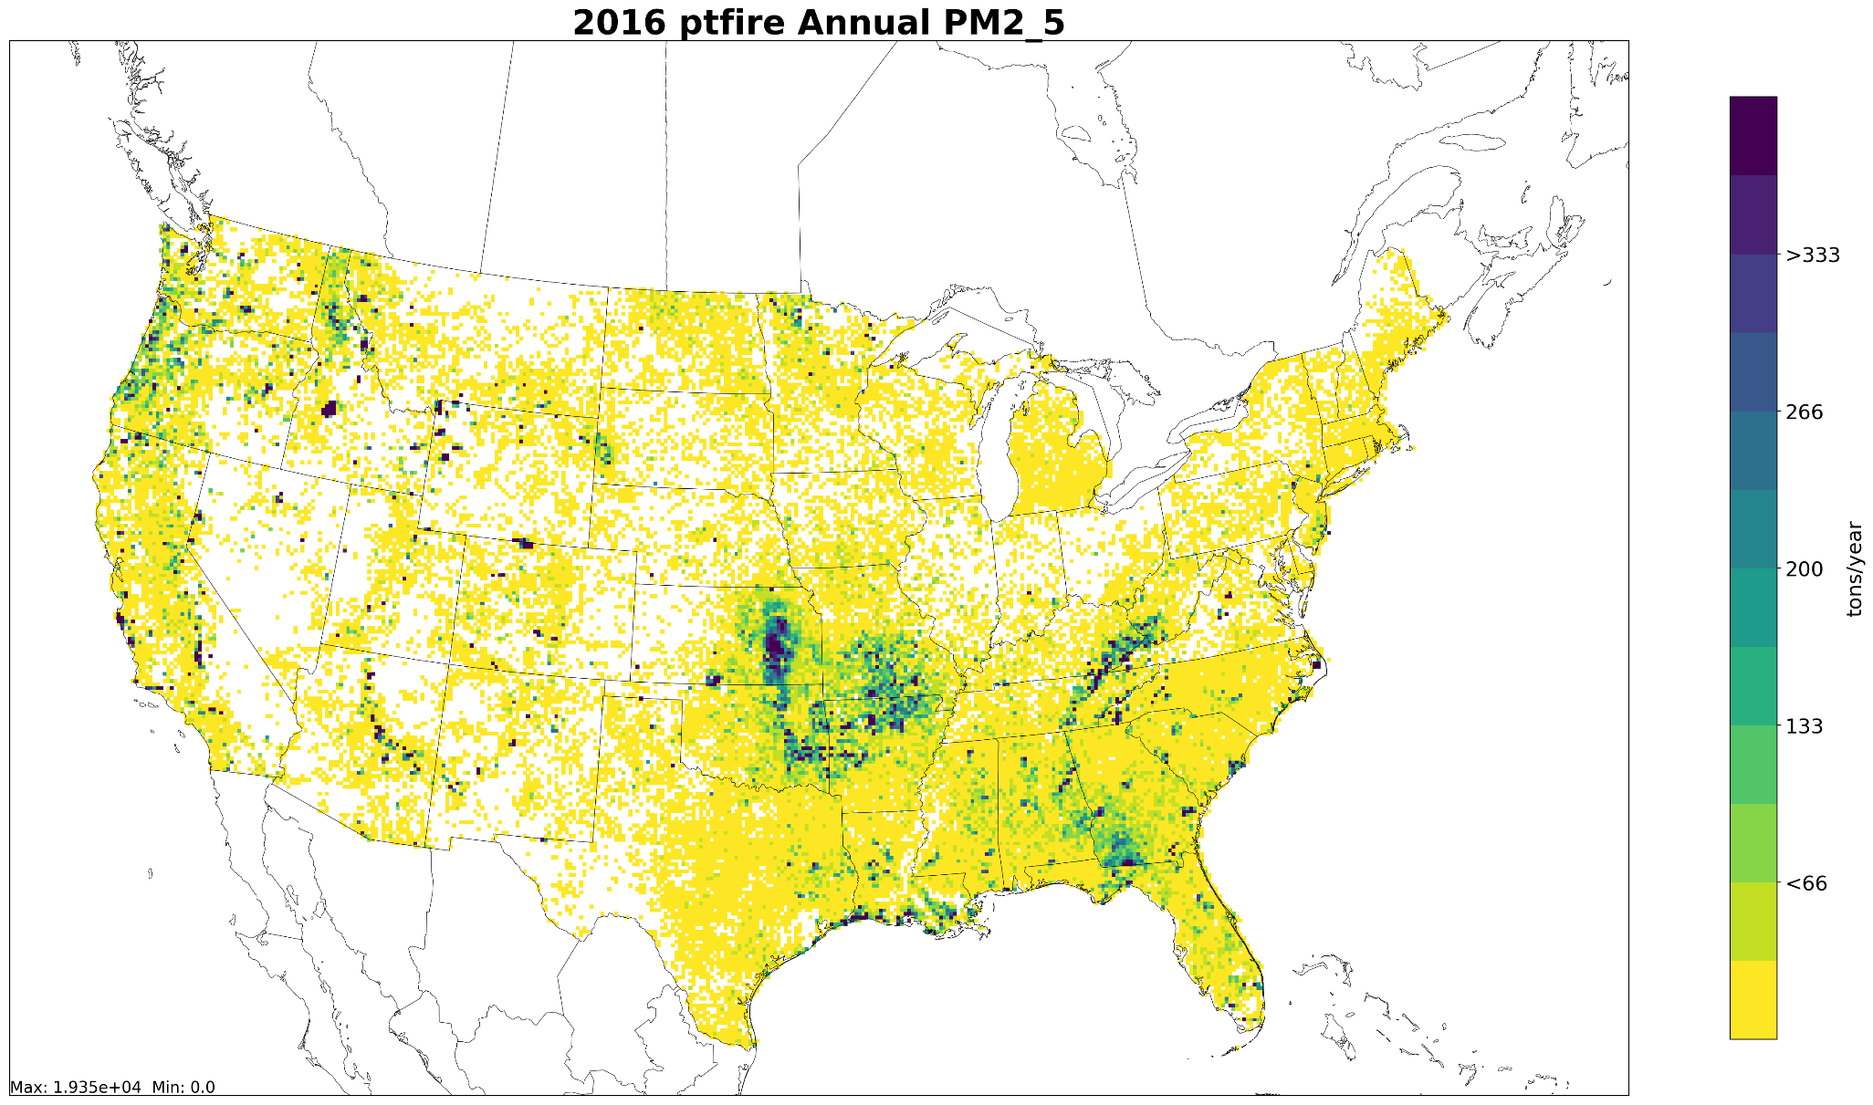
Gridded Annual PM2.5: 12km resolution
Includes wildfires and prescribed burns

Slide 75
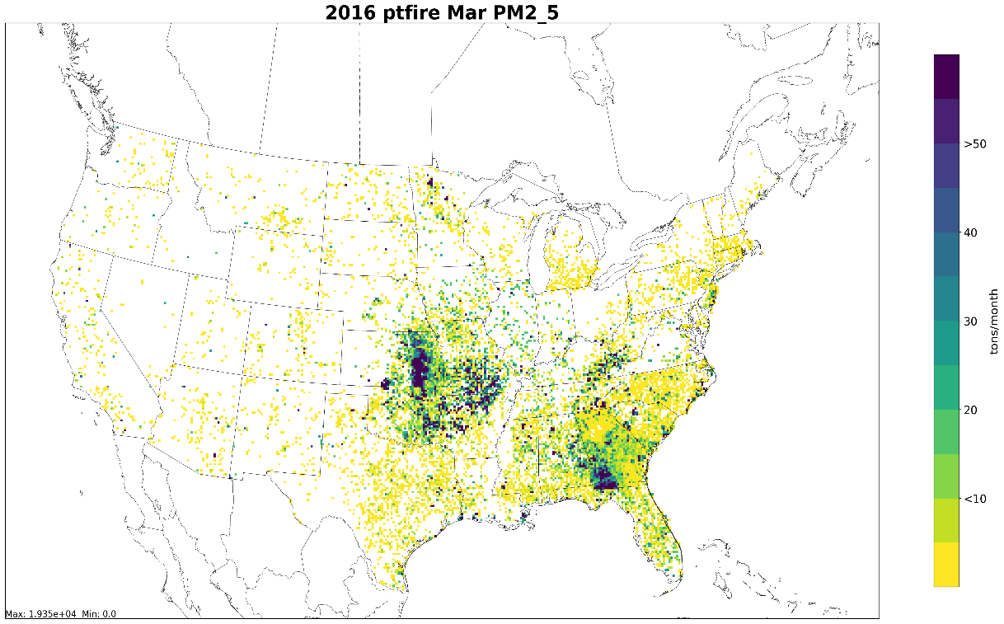
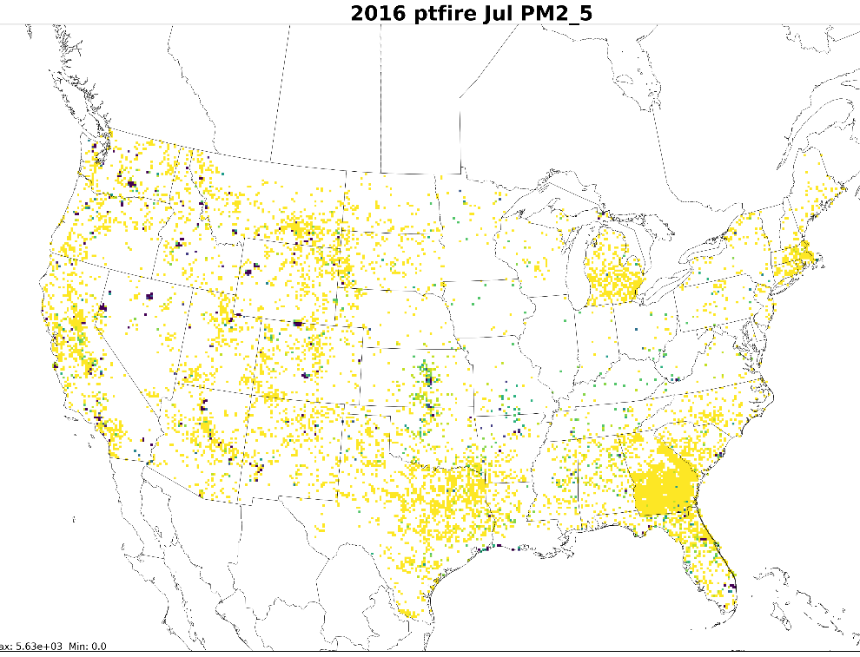
Gridded Monthly PM2.5: 12km resolution
March
July
60
Includes wildfires and prescribed burns

Slide 76
International Emissions
Environment and Climate Change Canada provided year 2015 data and factors to adjust to future years
Suspiciously high PM was noticed in Alberta / Saskatchewan and the Canadians agreed
Since beta, adjustments to PM in these areas were developed for regional haze and 2016v1 modeling
Mexico
2016v1 is based on a projection from the 2008 inventory
SEMARNAT has recently provided their 2016 inventory
EPA is working on converting the 2016 data to SMOKE format

Slide 77
Emissions Modeling Workgroup
Co-leads: Eric Zalewsky (NYSDEC), Zac Adelman (LADCO)
Wiki: http://views.cira.colostate.edu/wiki/wiki/9190

Slide 78
Emissions Modeling Workgroup
Approach: To test and help document the emissions modeling platform
Work to-date on 2016v1
LADCO using platform scripts and data and are processing through SMOKE
Created plots and charts for comparison to past platforms
Reviewed 2016v1 documentation
NYSDEC, LADCO & VADEQ developed scripts and documentation to incorporate ERTAC EGU option in v1 platform

Slide 79
Emissions Modeling Workgroup
Plans for the next quarter
Detailed analysis of the 2016v1 emissions: comparison to past EMPs (2011, 2014, 2016beta), evaluate ancillary data
Process new modeling domains and conduct air quality modeling/analysis
Compare 2016v1 to beta and previous national modeling platforms
Process future year inventories (2023 & 2028)

Slide 80
EPA-State 2016 Model Evaluation Forum
Goal of Forum
To promote collaboration with state partners on characterizing and understanding model performance and identifying performance issues for possible further research by EPA and/or the modeling community and to serve as a venue for sharing data and evaluation results
Membership: 92 members:
Environment Canada, EPA, BLM, NPS, 25 states, 4 local air agencies, MJOs
Workgroup meetings are ongoing now
Model inputs and outputs for beta platform are on the IWDW
Plots are on LADCO’s web site
https://www.ladco.org/technical/modeling-results/epa-2016-modeling
SharePoint site allows forum members to access information about the forum, the model simulations, past and upcoming meetings, available data, discussion board, and wiki page
The forum is expected to continue as 2016v1 modeling results become available

Slide 81
2016v1 Emissions Summaries
Agriculture
Airports
Biogenic
Commercial Marine Vehicles, C1&2
Commercial Marine Vessels, C3
Area/Nonpoint
Off-road Mobile
Nonpoint Oil & Gas
On-road Mobile
Point Oil & Gas
Agricultural Fires
Electricity Generating Units
Wild and Prescribed Fires
Non-EGU Point
Rail
Residential Wood Combustion
Annual totals mask temporal variability in the data
2016v1 Platform: 2016, 2023, 2028 emissions
Comparisons across recent inventory base years (2011, 2014, 2016)
Summaries of key ”Criteria” pollutants: CO, NOx, VOC (O₃ precursors); PM_{2.5}, SO₂, NH₃ (PM & haze precursors)
More results are available from the IWDW and LADCO websites

Slide 82
Annual Total 12km CO Emissions

Slide 83
2016v1-beta Annual Total 12km CO Emissions

Slide 84
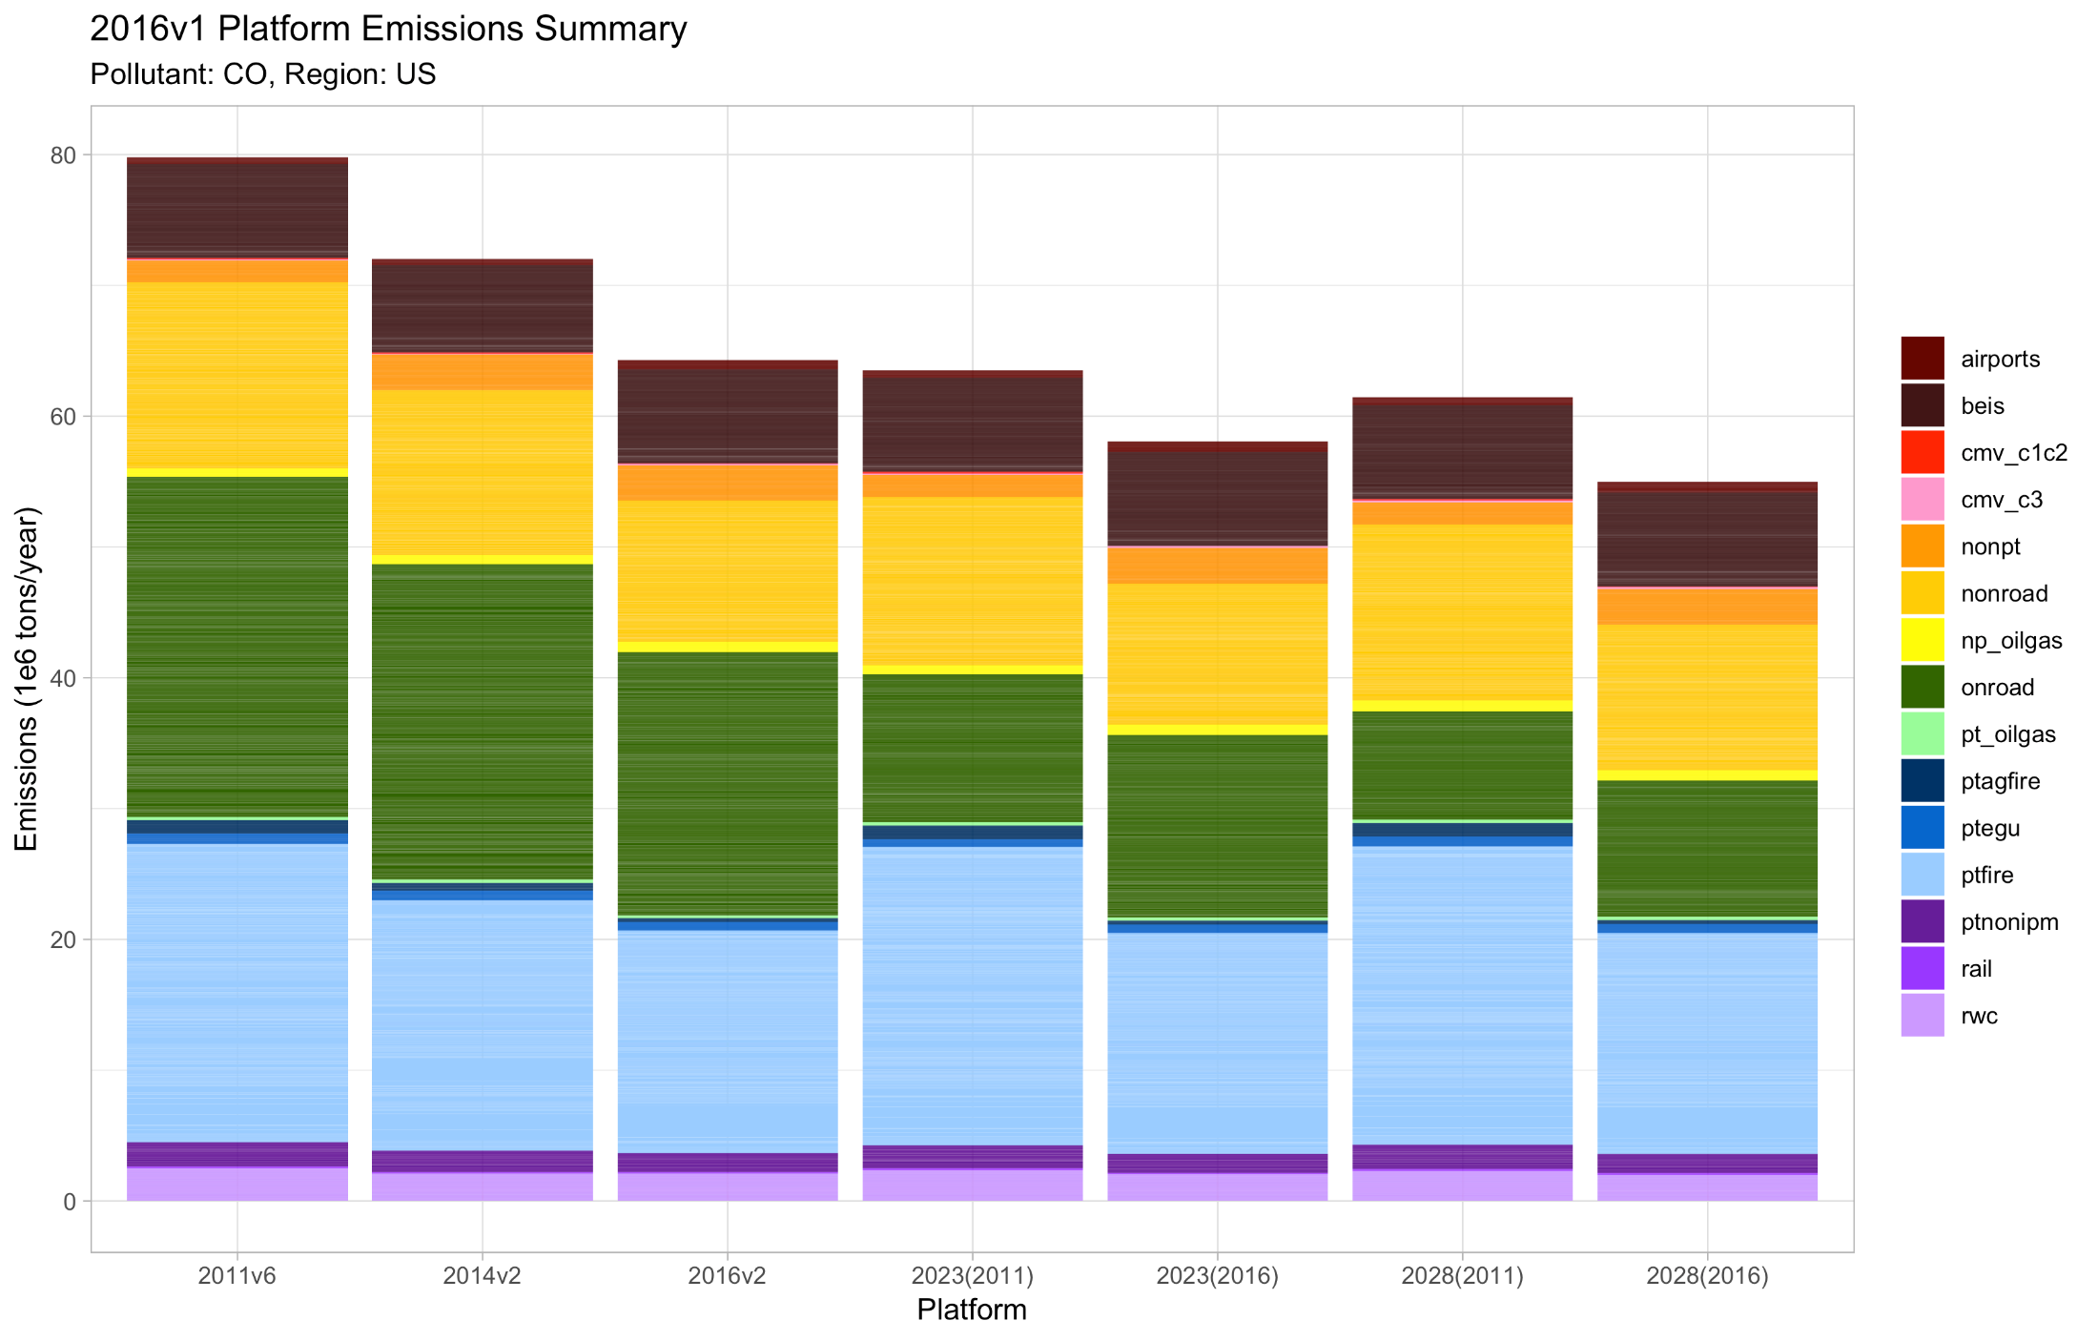
National Annual CO Emissions
2011 2014 2016v1 2023₂₀₁₁ 2023₂₀₁₆ 2028₂₀₁₁ 2028₂₀₁₆

Slide 85
National Annual CO Emissions
Overall 2016-based projections are lower than 2011-based projections, due to fires
Declining emissions
Biogenic
Off-road Mobile
Onroad Mobile
Onroad and nonpoint sector CO projections are higher in the 2016v1 platform than the 2011 platform
Fires were lower in 2016 than 2011 and 2014
2011 2014 2016v1 2023₂₀₁₁ 2023₂₀₁₆ 2028₂₀₁₁ 2028₂₀₁₆

Slide 86
Annual Total 12km NOx Emissions

Slide 87
2016v1-beta Annual Total 12km NOx Emissions

Slide 88
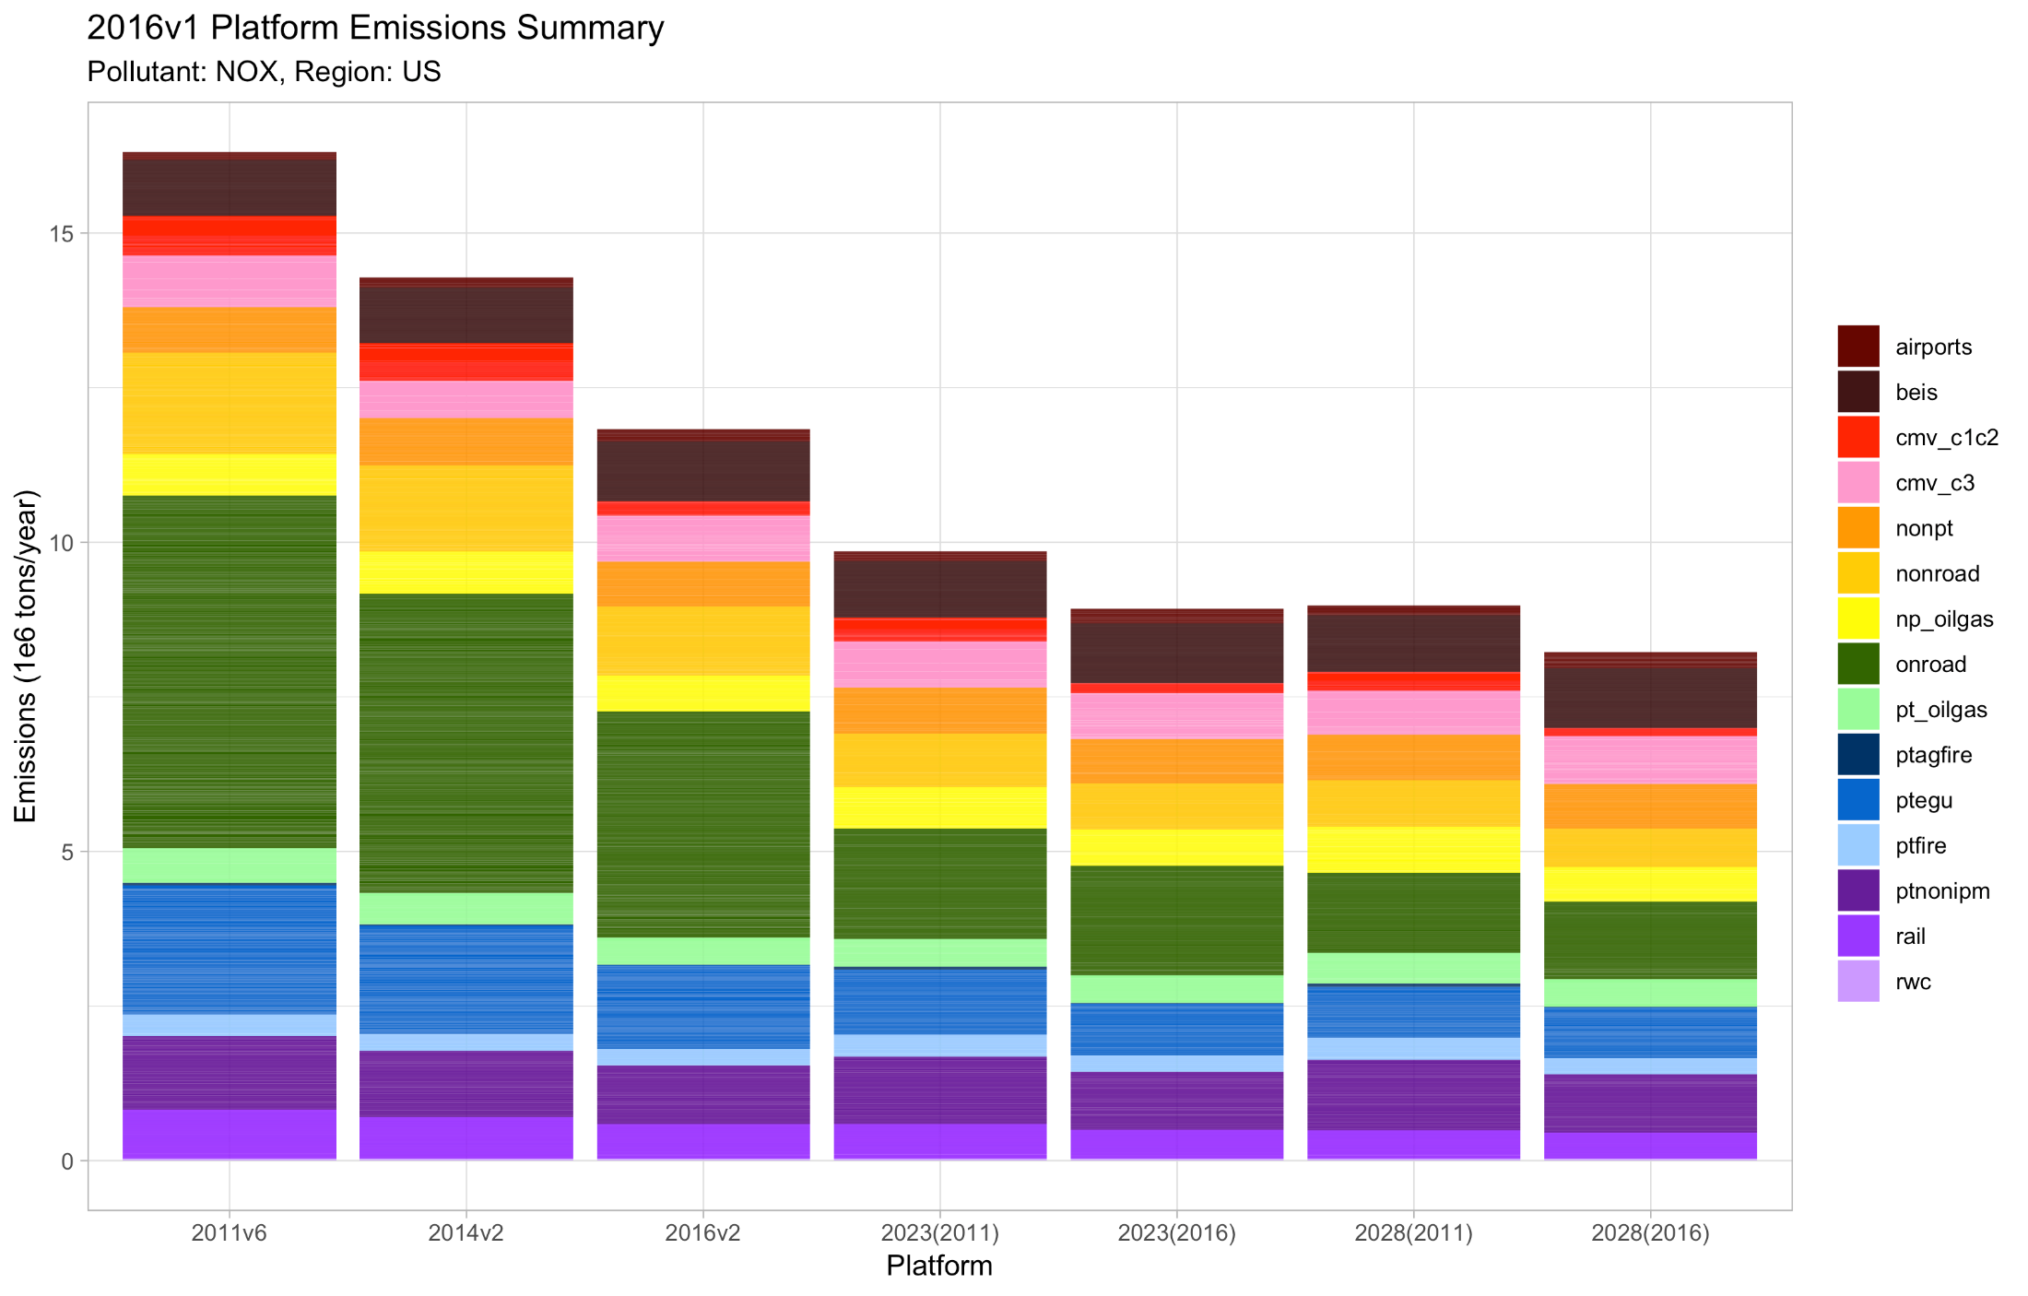
National Annual NOx Emissions
2011 2014 2016v1 2023₂₀₁₁ 2023₂₀₁₆ 2028₂₀₁₁ 2028₂₀₁₆

Slide 89
National Annual NOx Emissions
Declining emissions
Lower emissions in most sectors produced 2016-based projections that are lower than 2011-based projections
Onroad Mobile
EGU Point
2011 2014 2016v1 2023₂₀₁₁ 2023₂₀₁₆ 2028₂₀₁₁ 2028₂₀₁₆

Slide 90
Annual Total 12km VOC Emissions

Slide 91
Annual Total 12km Biogenic VOC Emissions

Slide 92
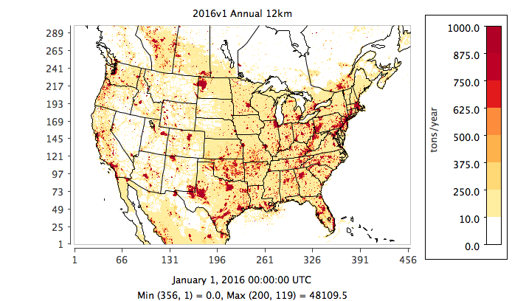
Annual Total 12km Anthropogenic VOC Emissions
Notes:
Urban areas, oil and gas, fires

Slide 93
2016v1-beta Annual Total 12km VOC Emissions

Slide 94
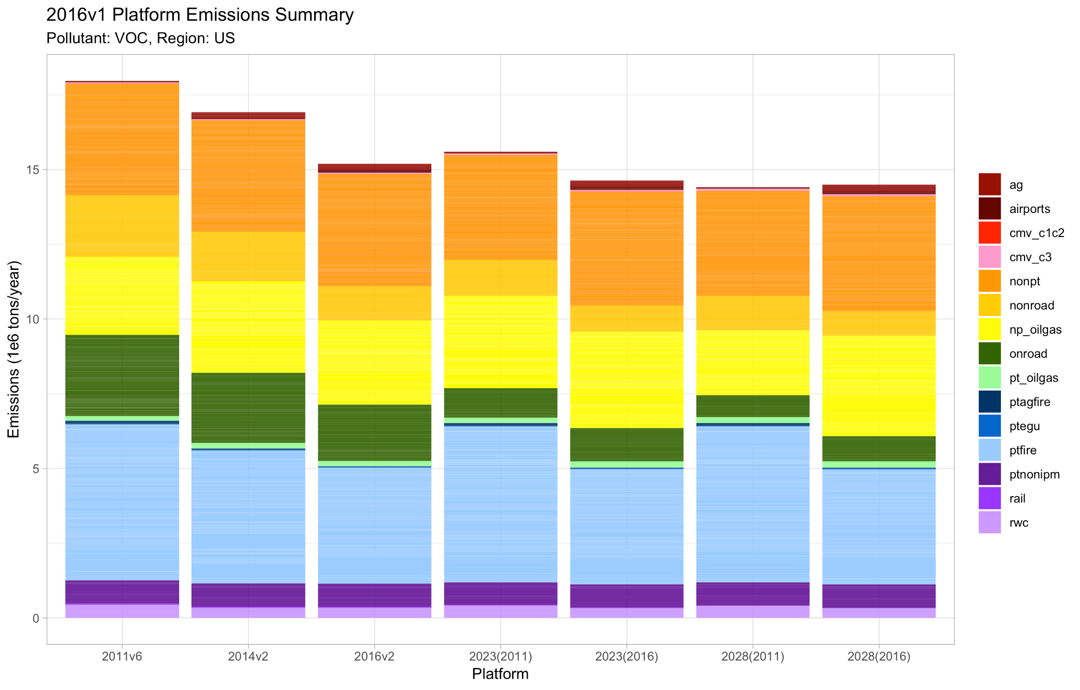
National Annual VOC* Emissions
2011 2014 2016v1 2023₂₀₁₁ 2023₂₀₁₆ 2028₂₀₁₁ 2028₂₀₁₆
*Anthropogenic Sources Only

Slide 95
National Annual VOC* Emissions
Higher oil & gas and nonpoint in 2016 platform offset lower fire emissions;
2016-based 2028 projection > 2011-based
Mobile was lower in 2016 than other base years
Fires were lower in 2016 than other base years
2011 2014 2016v1 2023₂₀₁₁ 2023₂₀₁₆ 2028₂₀₁₁ 2028₂₀₁₆
*Anthropogenic Sources Only
Notes:
Mobile = onroad and nonroad

Slide 96
Annual Total 12km NH₃ Emissions

Slide 97
2016v1-beta Annual Total 12km NH₃ Emissions

Slide 98
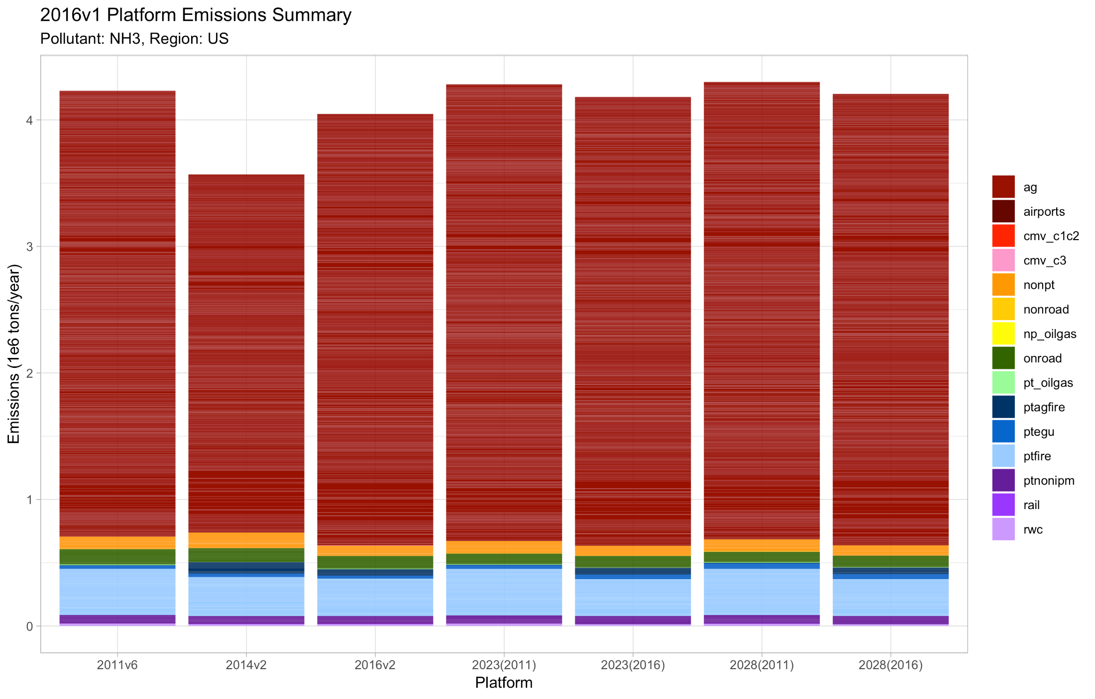
National Annual NH₃ Emissions
2011 2014 2016v1 2023₂₀₁₁ 2023₂₀₁₆ 2028₂₀₁₁ 2028₂₀₁₆

Slide 99
National Annual NH₃ Emissions
Ag and fires drive the overall reductions in the 2016-based projections relative to 2011
Agriculture: Livestock and Fertilizer
Fires
2011 2014 2016v1 2023₂₀₁₁ 2023₂₀₁₆ 2028₂₀₁₁ 2028₂₀₁₆

Slide 100
Annual Total 12km SO₂ Emissions

Slide 101
2016v1-beta Annual Total 12km SO₂ Emissions

Slide 102
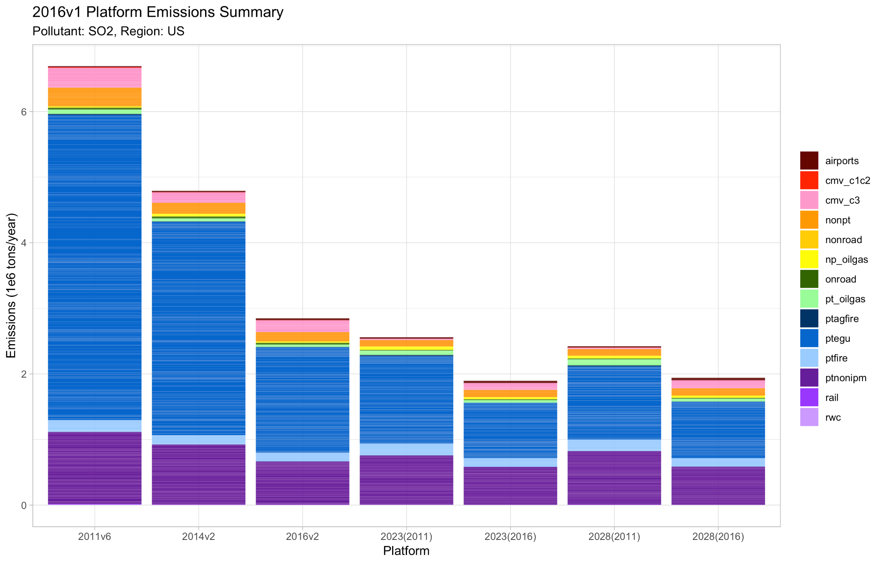
National Annual SO₂ Emissions
2011 2014 2016v1 2023₂₀₁₁ 2023₂₀₁₆ 2028₂₀₁₁ 2028₂₀₁₆

Slide 103
National Annual SO₂ Emissions
Declining emissions
2016-based projections include more recent information on changes in the stationary point sectors, leading to lower projections than 2011-based platform
EGU Point
Non-EGU Point
2011 2014 2016v1 2023₂₀₁₁ 2023₂₀₁₆ 2028₂₀₁₁ 2028₂₀₁₆

Slide 104
Annual Total 12km PM_{2.5} Emissions

Slide 105
2016v1-beta Annual Total 12km PM_{2.5} Emissions

Slide 106
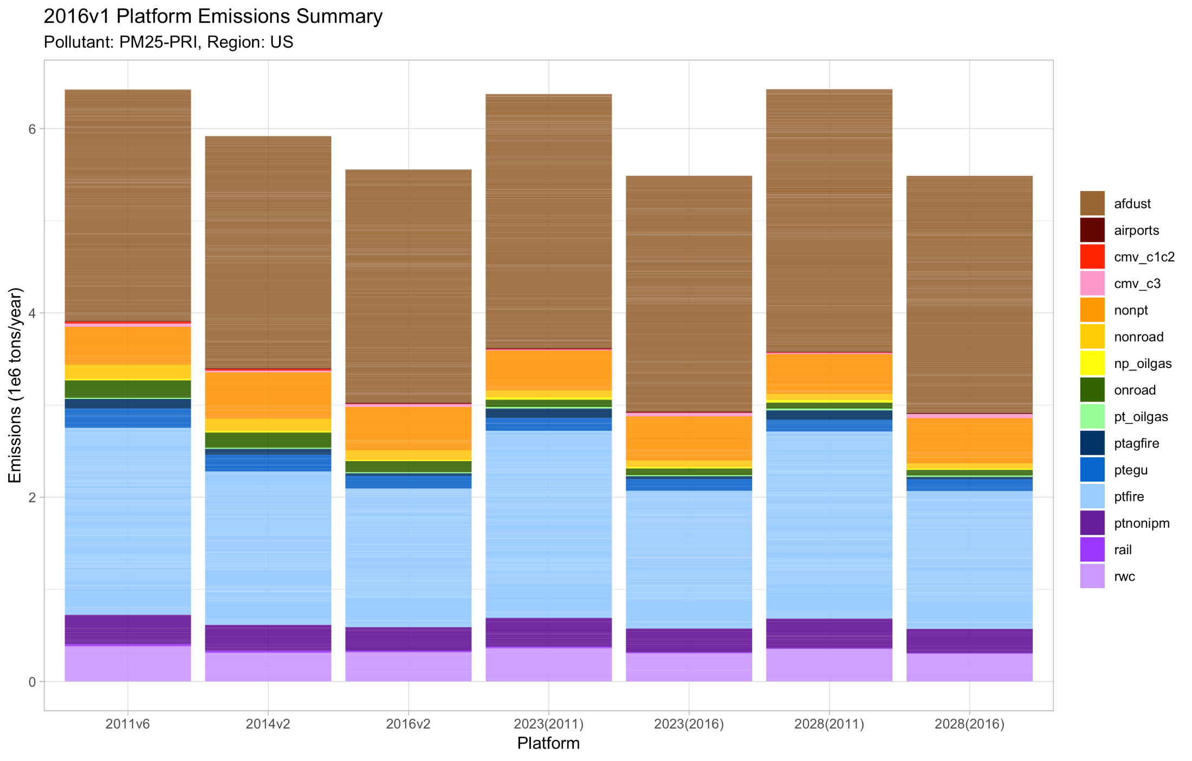
National Annual PM_{2.5} Emissions
2011 2014 2016v1 2023₂₀₁₁ 2023₂₀₁₆ 2028₂₀₁₁ 2028₂₀₁₆

Slide 107
National Annual PM_{2.5} Emissions
Declining emissions
Fugitive Dust
Differences in base year fires drive the changes in the future year emissions
Fires
2011 2014 2016v1 2023₂₀₁₁ 2023₂₀₁₆ 2028₂₀₁₁ 2028₂₀₁₆

Slide 108
Base Year Comparison Plot 2016v1-2011v6 & 2016v1-2016beta
0
0
0
0
0
0
0
>0 = higher emissions in 2016v1
2016v1 platform has lower fire emissions than both 2011 and 2016beta
Nonpoint and oil & gas are higher in 2016 vs 2011
Big reductions in point SO2 in 2016 vs 2011

Slide 109
Future Year Comparison Plot 2023₂₀₁₆-2023₂₀₁₁ & 2028₂₀₁₆-2028₂₀₁₁
0
0
0
0
0
0
>0 = higher emissions in 2016v1 projections
Differences highlighted previously are illustrated here, e.g., onroad CO and O&G VOC are higher in 2016-based platform; lower fires in 2016; lower ag NH₃ in 2016; lower EGU SO₂ in 2016
0

Slide 110
What other plots are available?
By Pollutant and MJO/Region
By Pollutant, Sector, and County
By Pollutant and State within a Region

Slide 111
What other plots are available?
Gridded 36km by Sector and Pollutant
Profile Plots for Top 10 SCCs in each State/Sector
Gridded 12km by Sector and Pollutant

Slide 112
Inventory Collaborative Next Steps
Post final 2016v1 documentation
Review of air quality modeling with 2016v1
Collect information on uses of the v1 platform
Next outreach call by the Collaborative will report out on air quality modeling applications and provide updates on emissions:
Next outreach call:
April 29, 2020 at noon Eastern

Slide 113
Inventory Collaborative Next Steps
Internal discussions about how the Collaborative will operate moving forward
Many of the workgroups will begin to meet on an ad hoc basis
Some workgroup members will shift back to focusing on other national emissions workgroups (e.g., IPM, ERTAC, Oil and Gas)
Seeking thoughts from the community about the value of the collaborative process to building an EMP
What can be improved? What worked well?

Slide 114
Inventory Collaborative Wiki Links
These slides, answers to the questions posed during this webinar, notes:
http://views.cira.colostate.edu/wiki/wiki/11202
Main National Inventory Collaborative Wiki includes workgroup wikis, documentation, etc:
http://views.cira.colostate.edu/wiki/wiki/9169
LADCO Plot Viewer
https://www.ladco.org/technical/modeling-results/2016-inventory-collaborative/
IWDW Interactive Plotting Tool
http://vibe.cira.colostate.edu/iwdwx/Emissions/2016EMP

